Slide 1


How to Use Your PSN
Account Management Center (AMC)
Use the arrows on your keypad to move forward (→) or go back (←) to a slide.
A next arrow will appear when the slide is complete and you can advance at any time to the next slide.
NEXT

Slide 2
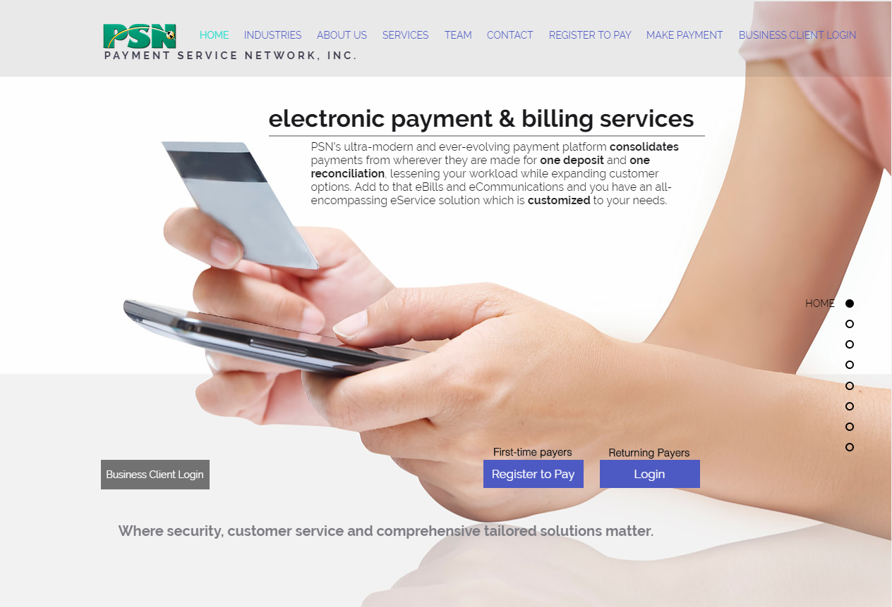
AMC login
NOTE: You must have an administrator in your company set you up as a user before you can log into the AMC. Your administrator decides what functions you can do in the AMC.
There are 3 types of users. Ask the administrator which one you are:
READER: Can only view info & change password
PROCESSOR: View info, change passwords + make payments
ADMINISTRATOR: Can do all
Once you are set up…
Go to
www.PaymentServiceNetwork.com
Click on Business Client Login
NEXT

Slide 3
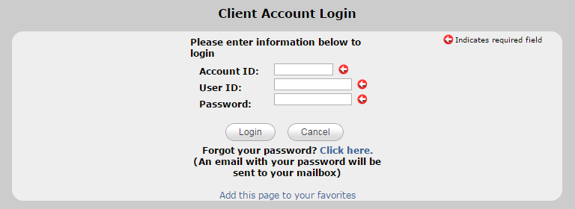
AMC login
BEFORE YOU LOG IN…
Save this page to your Favorites, so that future logins are quicker
https://www.paymentservicenetwork.com/ClientLogin.aspx
THEN…
Enter Account ID, User ID, Password (Provided by your administrator)
LATER…
If you forget your password, use the “Click here” feature
NEXT

Slide 4
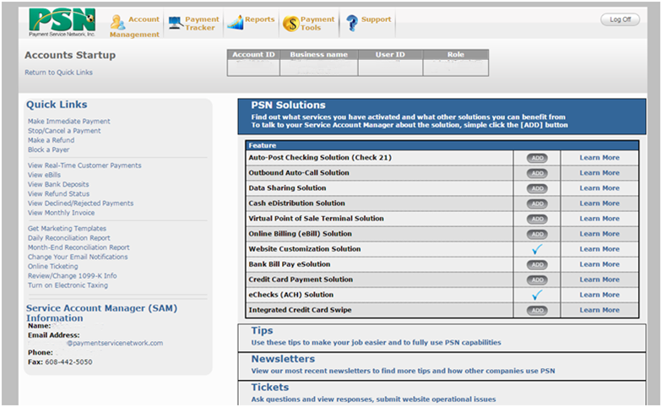
Getting around via Quick Links
Return to Quick Links from any page
Use Quick Links to navigate to the most frequently used functions
NEXT

Slide 5
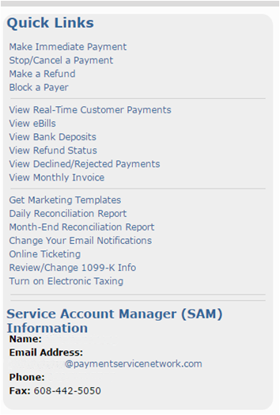
Getting around via Quick Links
Payment Management
Viewing Reports
Administration
Your PSN Contact
NEXT

Slide 6
Getting around: Viewing payments
View Real-Time Customer Payments
NEXT

Slide 7
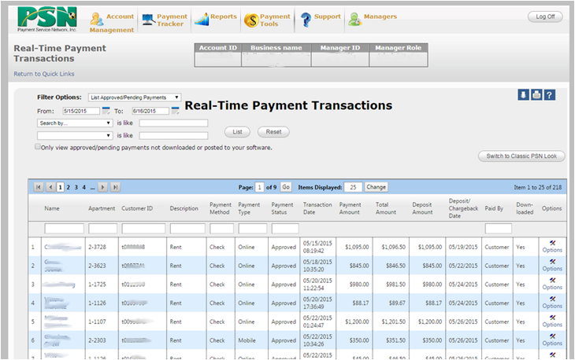
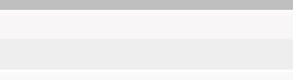
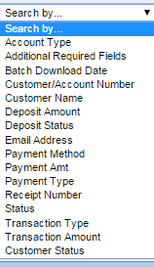
Viewing real-time payments
You can view in real time any payment made through PSN.
Select a date range
You can narrow the search by other criteria
NEXT

Slide 8
Viewing real-time payments
You can SORT by clicking on the field name
You can print or download a report
Smith
You can FILTER by typing in criteria under the field name
NEXT

Slide 9
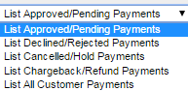
Viewing real-time payments
You can view other reports, as well
Smith
NEXT

Slide 10
Getting around: Block a payer
Block a Payer
NEXT

Slide 11
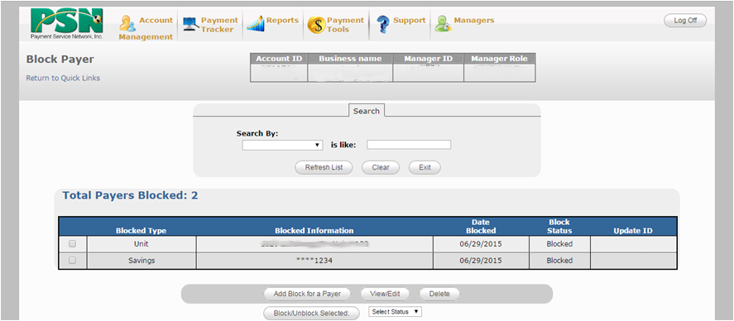
Block a payer
If you want to block a payment by a unit or method of payment, you can do so here. You can also release a block or change it.
Select your action
NEXT

Slide 12
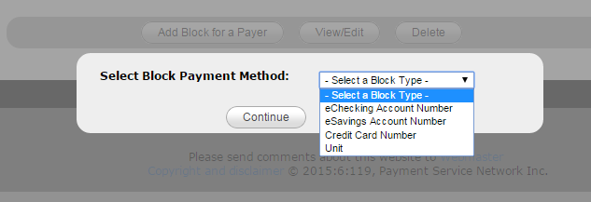
Block a payer
First, select how you want to block (checking/savings account, unit).
Blocking by unit doesn’t guarantee that the customer won’t put in a non-standard unit number that the “block” would miss.
NEXT

Slide 13
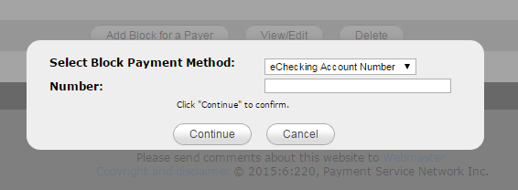
Block a payer
Enter the unit, check or savings account number
NEXT

Slide 14
Getting around: Make a payment
Make a payment
NEXT

Slide 15
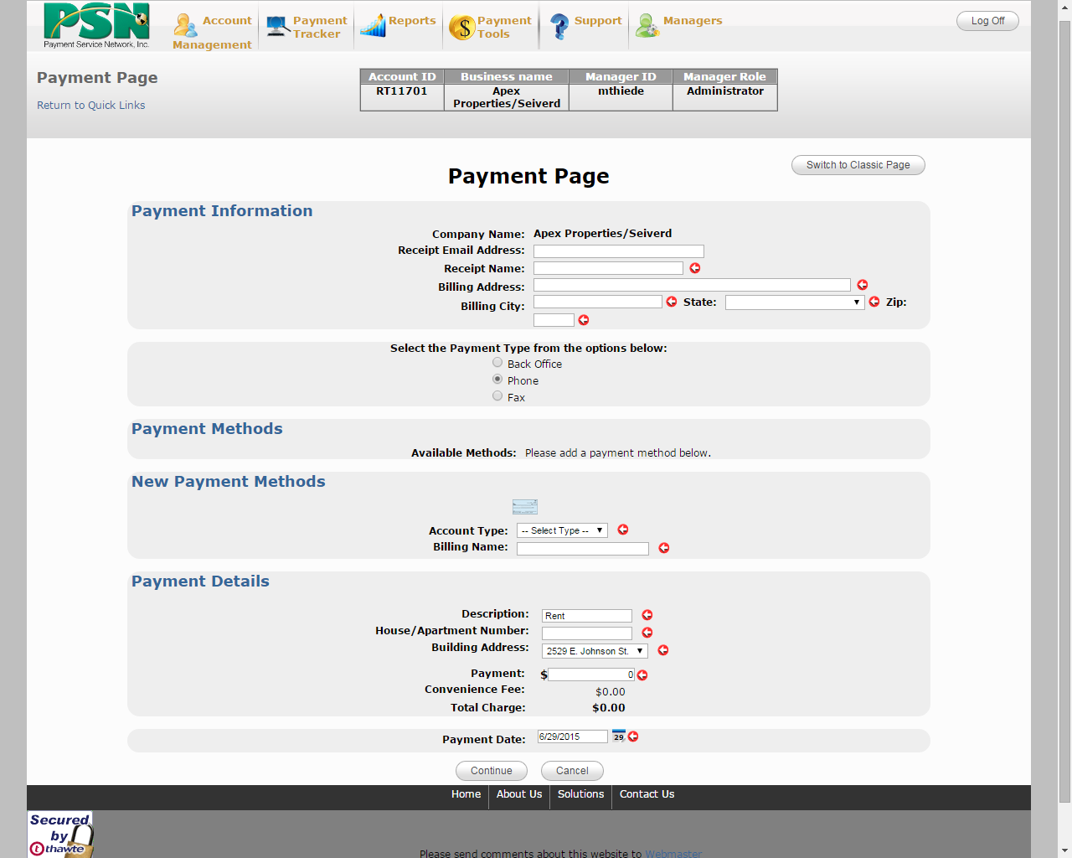

Make a payment
1
Fill in customer info
2
Only those methods allowed by your company will appear.
Set up a payment method
Enter the payment amount and date to be paid
3
The next page will display the information for confirmation; if okay you will submit the payment and generate a receipt.
NEXT

Slide 16
Getting around: Change your profile
Change Your Email Notifications
NEXT

Slide 17
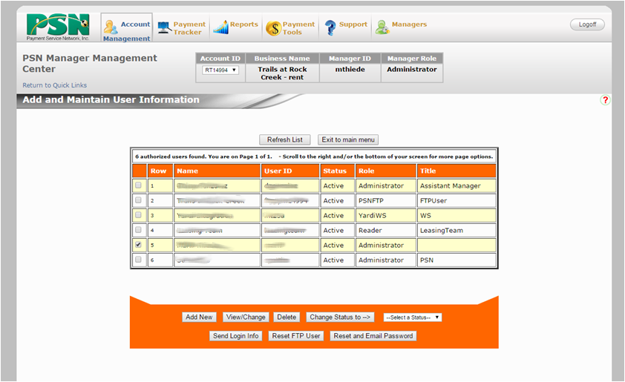
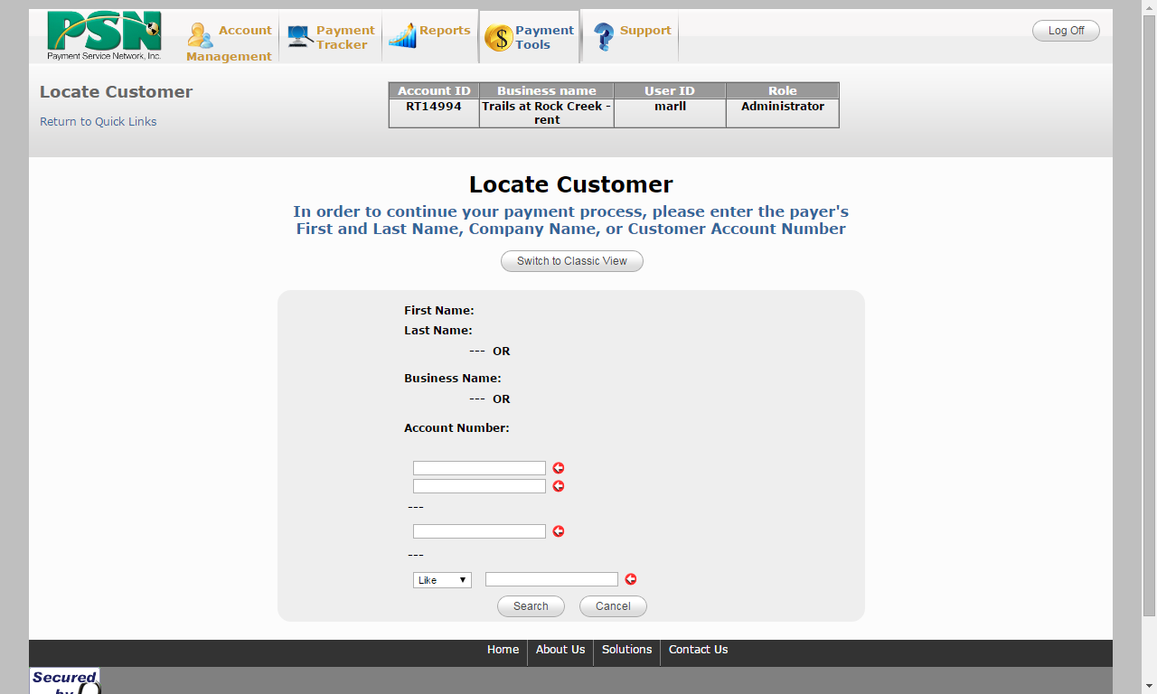
Changing your profile
Select your name by checking the box
Select View/Change
Note: Only administrators can add new users.
NEXT

Slide 18
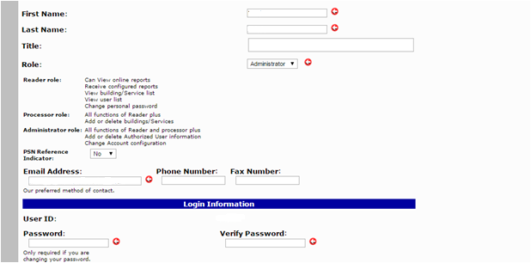
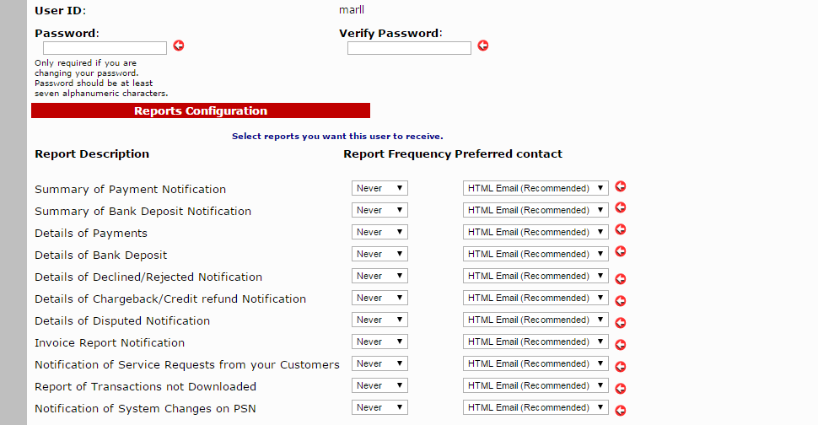
Changing your profile
IMPORTANT: All of these reports are available online in real-time. Online reports can be downloaded. Please depend on online information because we cannot guarantee the delivery of every email since it is beyond our control.
You can change your password or other profile information.
Only administrators can select which reports you would like emailed to you by selecting the frequency.
NEXT

Slide 19
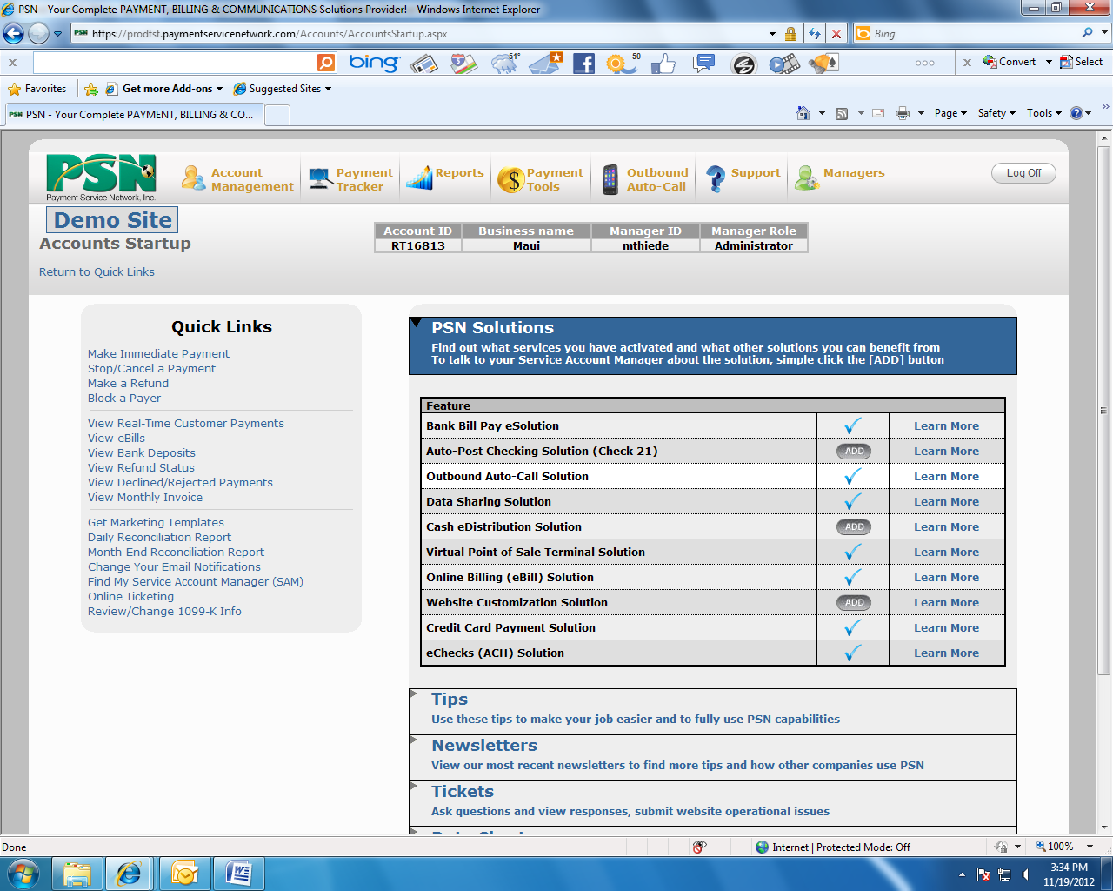
More functions in the tab menus
PAYMENT TRACKER
  View Real-time Payments
  View Deposits
  View Rejected/Cancelled
  View Payment Histories
  View Disputed Payments
  And more…
REPORTS
  View Registered Customers
  Perform Month-End Reconciliation
  Manage eBills
  And more…
PAYMENT TOOLS
  Make Payments on
  Behalf of Customers
  Set up/Change Auto-Pay
  Check Scanning
  And more…
OUTBOUND AUTO-CALL
  Manage Calls
  Upload Messages
  Upload Call Lists
  Set Date & Time
ACCOUNT MANAGEMENT
  Set Staff Access Levels
  Update Payment Page
  Upload/Download Data
  Multiple-Account Access
  Marketing Templates
  And more…
SUPPORT
Ticket Center
FAQs
And more…
Find more features in the tab dropdown menus.
When you are online, take a self tour.
NOTE: You may not have access to all features; it depends on what PSN services your property is signed up for (e.g., check scan, auto-call).
NEXT

Slide 20
Getting around: Getting assistance
Online Ticketing
NEXT

Slide 21
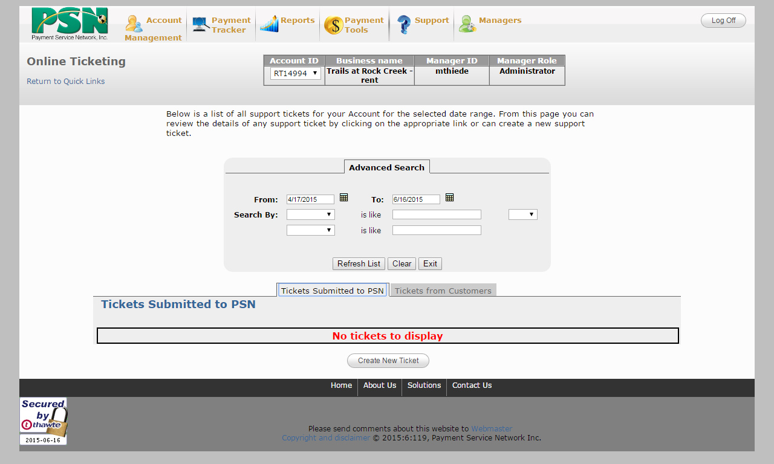
Getting help: Submit a ticket
If you have an issue with the PSN system, it is best to submit a ticket. You can track the progress of your ticket. PSN monitors the ticket to make sure your request is being addressed.
IMPORTANT: Be very specific in describing the issue—there can never be too much information!
NEXT

Slide 22
That’s it
Return to the AMC
and take a look around.
If you need more assistance, contact your Service Account Manager.

