Slide 1


Getting Started with Your Customers
6 Easy Steps to
Online Payment Success

Slide 2
Let’s Get Started
1
Now that you have selected the PSN online payment solution, it’s time to get started with your customers.
There are just six steps to take to get your customers to pay electronically, and you can begin realizing cost savings, an improved cash flow and, most importantly, enhanced customer relationships.
PSN is here to help you maximize your results while minimizing your work.
2
3
4
5
6

Slide 3
Step 1
Add links & info to your website
  CRITICAL: Add navigation on your home page. Don’t make people hunt for the link.
    Place the link high on the page (no scrolling)
    Link directly to PSN
    OR link to a page that explains online payments
    “Pay Your Bill Online” | “Pay Your Bill” | “Make a Payment” | etc.
  Use the unique url provided by PSN
    You may want to inform customers they are leaving your site for a secured payment site

Slide 4
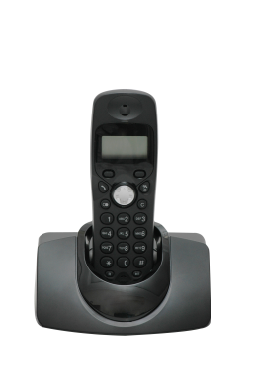

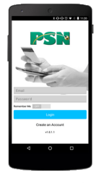
Step 2
Put information on your bill
On the front and back of the bill
  Pay online at [your website address]
  Pay by mobile app [app name provided by PSN]
  Pay by phone at [number provided by PSN]
  It is eye-catching to use computer and phone icons
  for attention (it can be clip art or PSN can provide images)

Slide 5
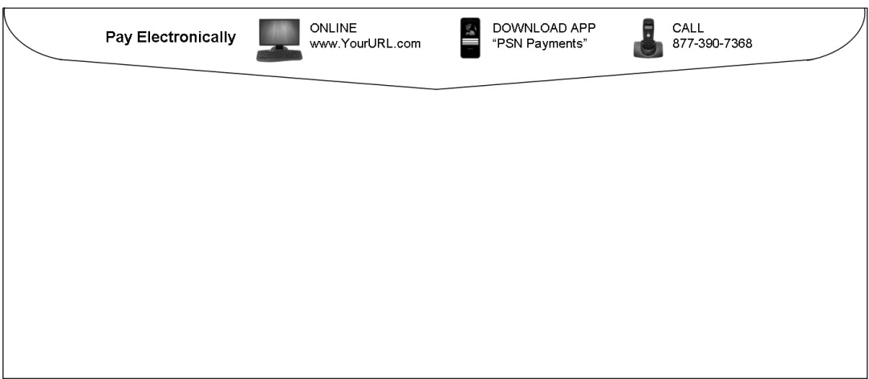

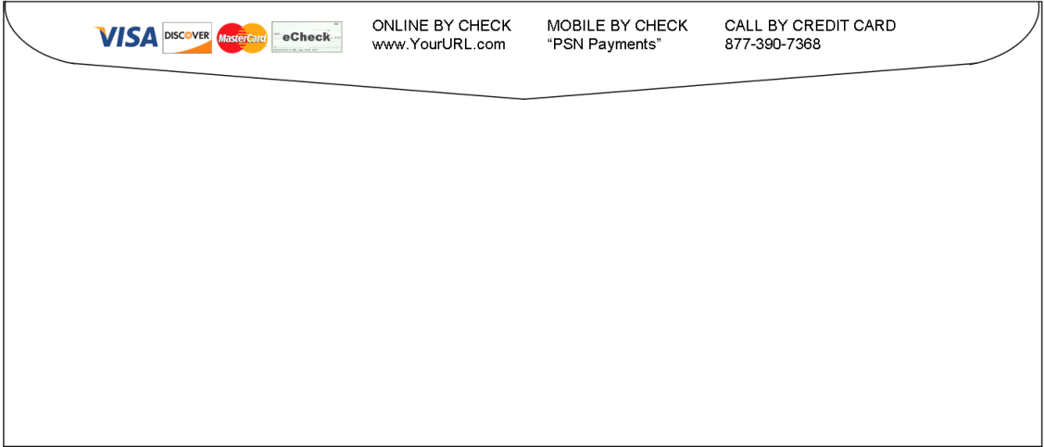


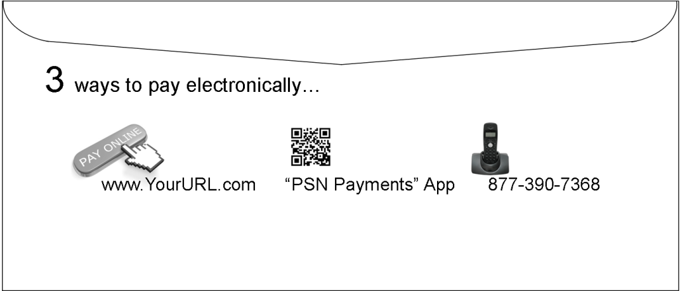

Step 3
Add “how to pay” info on envelopes
Sample images
If you use envelopes for billing, have the printer add information on the flap—generally at no cost. We can work with your printer, provide images and examples. Just let your Service Account Manager know.

Slide 6
Step 4
Create a plan
Consider including:
  Stuffers in your bills
  Letters or postcards
  Handouts
  Posters
  Email notifications
  Press release or interview with local media
  Running contests to promote the new service
  A downloadable plan is available in the How-To section
  Schedule when each is to happen; make sure to repeat efforts continually.

Slide 7


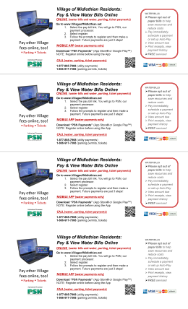

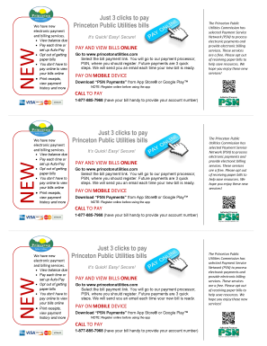
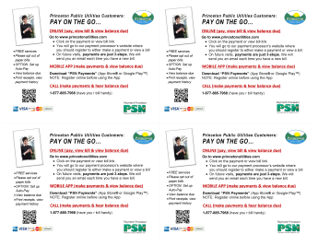
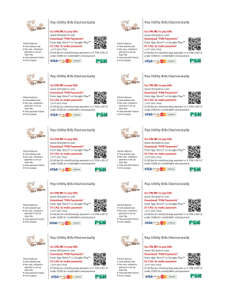
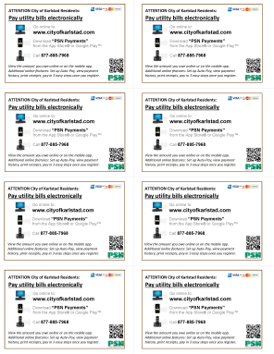
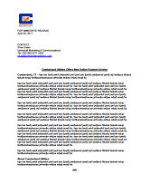
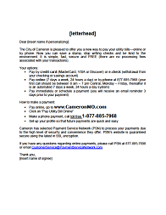
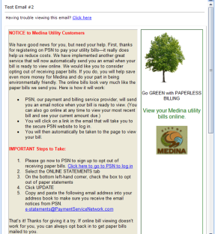

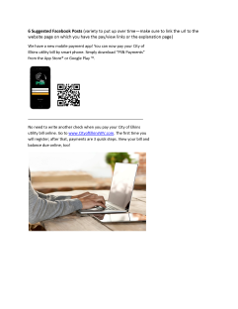
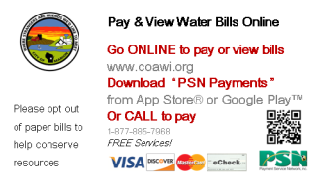
Step 5
Use PSN templates to create marketing pieces
Poster
Poster Tear-off Tags
Full-page Handout
or Stuffer
Stuffer (3-up)
Stuffer/Post Card (4-up)
Business Cards
Mini Handouts
Press Release
Letter
Email
Facebook Posts
  Order your marketing templates by going to the
  How-To Guides and downloading the form
TYPES

Slide 8














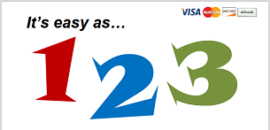














Step 5
Use PSN templates to create marketing pieces
Technology
No More Checks
Whimsical
Credit Card
Parent with Child
B
Mobile
Family
Young Couple
Seniors
Green
  Order your marketing templates by going to the
  How-To Guides and downloading the form
THEMES

Slide 9
Step 6
Train staff who come in direct contact with payers
  Use the How Customers Make Payments presentations
  Have them make a practice payment, so they can tell customers how easy it is (you can cancel this payment right away)
  Make sure they understand the importance to your company as to why they should help persuade customers to pay online
  Teach them what to say to customers who come in or call
  Have handouts on “how to pay” at all customer service areas
  Note: This can be difficult for some Customer Service Reps, since they may enjoy customers coming into the office and would feel awkward about telling them to now pay online or by phone; so this should be a part of the training discussion.

Slide 10
Incentive
Use incentives to encourage customers
  Apply a monthly incentive discount for a specified number of months
    Generally calculated as a percentage of the savings realized from fewer customer service calls, reduction of paper remittances, less data input,
    fewer errors and improved cash flow
  Apply a one-time incentive discount
    Generally calculated as a percentage of the savings realized over a number of months
  Run a contest
    For each payment made online or by phone over the next 3 months, they get an entry into a drawing for a FREE “something” or cash or one month credit up to a specified amount
      Running the contest over a three-month period helps establish a pattern of behavior which they will be more likely to continue after the three months
      Local businesses may be happy to donate a prize in exchange for the publicity

Slide 11
Set Goals
The more customers who pay online, the greater the benefits to your organization. But like everything else in life, you can’t just “build it and they will come.” It is important to set goals, execute your plan and then measure your results.
What percentage of customers do you want to pay online by the end of:
  1st quarter
  2nd quarter
  3rd quarter
  First year
  5 years
  10 years (hopefully, everyone!)
You can measure your progress by running reports on PSN
Consistent messaging is critical to meeting your goals
If you are not meeting your goals, call us. We can help with ideas or additional PSN solutions which may help convert more paper to electronic payments

Slide 12
That’s It!
Informing your customers is an ongoing process, and we will help you along the way.
Each year, you should develop a new plan for what you will do to have more and more customers pay online. We can help with new marketing pieces or other ideas.
  These few steps are all it takes to have a successful transition
  to PSN’s online and phone payment service.
  Add links and information to your website
  Put “how to pay” info on bill
  Add “how to pay” information on your billing envelope
  Create a marketing plan to inform customers
  Create marketing pieces
  Train your staff

Slide 13
Contact your Service Account Manager for ideas,
brainstorming, examples, templates or questions
Voice: 866.917.7368
Email: CustomerService@PaymentServiceNetwork.com

