Slide 1
How Your Customers Pay Online

Slide 2
Online payments are simple
Once registered, online payments are 3 simple steps.
Your customers can make an immediate payment, schedule a payment or set up Auto-Pay, recurring payments, if applicable.
Importantly, we have Customer Service Representatives that will assist your customers should they have difficulty.

Slide 3
Contents
This presentation has five parts. You can skip through those that don’t apply to you. NOTE: Some companies use more than one type of account.
PART 1 Customer Authentication: Integrated Payment Accounts
If your software system shares data with PSN, then you have an integrated account. Your customers will authenticate and register themselves to use PSN
PART 2 Customer Registration: Non-integrated Payment Accounts
If your system is not integrated with PSN, your customers will register to use PSN
PART 3 The Customer Payment Experience
Making a one-time payment (immediate or scheduled) and setting up Auto-Pay
PART 4 Customer Profile
Where your customer can store information and manage their PSN payment account
PART 5 Quick Pay Accounts
If your company participates in PSN’s Quick Pay and your account is integrated with PSN, your customers can authenticate themselves without registering

Slide 4
PART 1: Customer validation for integrated payment accounts
Please keep in mind, that because PSN can customize its services for each business, there may be variances in the slides and explanations shown. If you have any questions as to how your customers pay, contact your Service Account Manager.

Slide 5
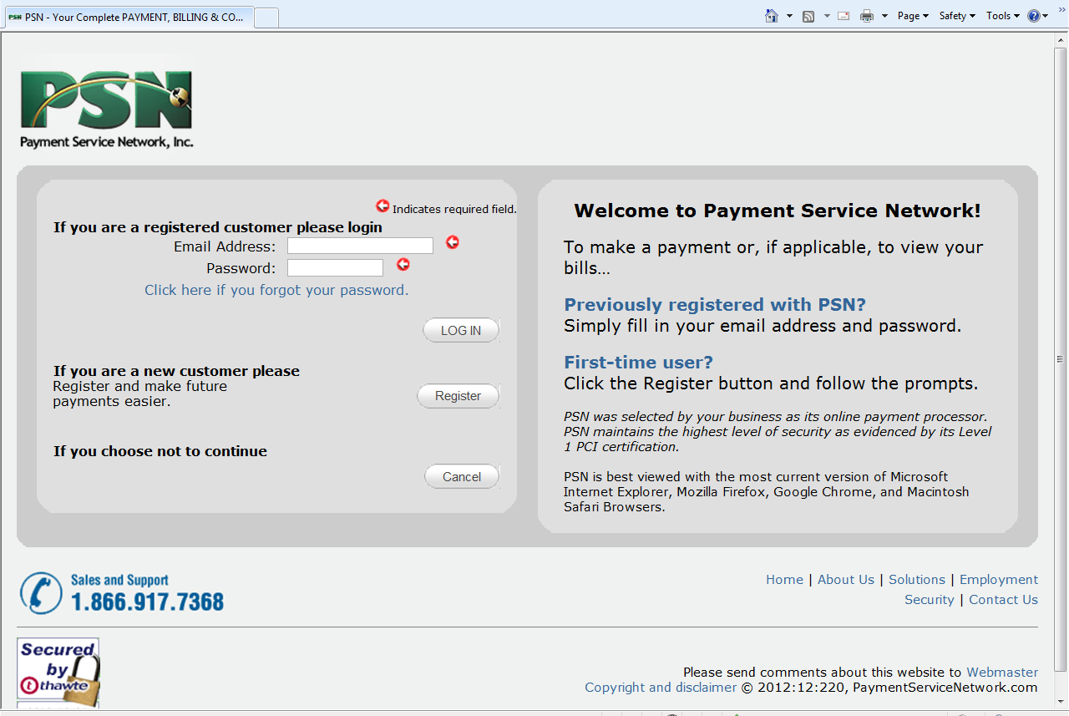
Customer’s first visit
Validation process…
If you pass your customer data to PSN, your customer will validate themselves
Customer should select Register the first time they go online to make a payment or view a bill

Slide 6
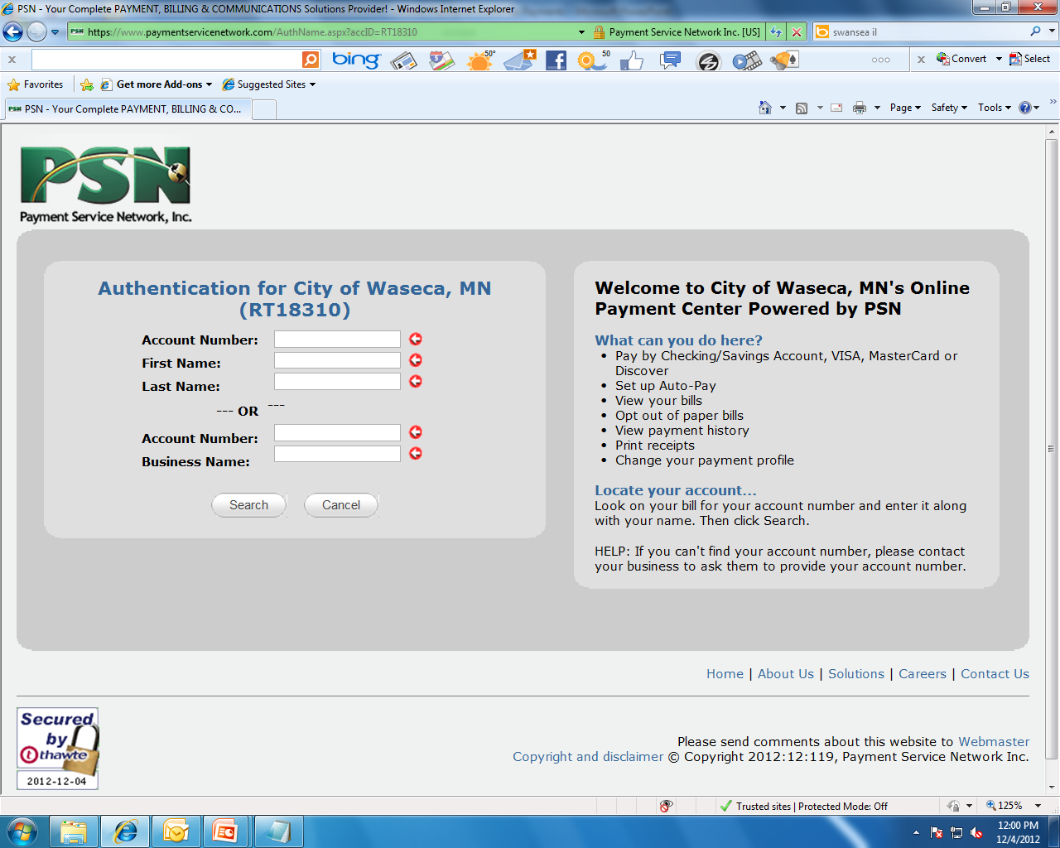
Authentication process
Customer will enter their:
Customer Account Number
First Name (optional)
Last Name
HELP: Their name should be entered as it is listed on their bill
Select “Search”
Your Name Appears Here
Your Name Appears Here
xxxxx

Slide 7
Authentication process
Your Name Appears Here
Your Name Appears Here
Customer info will appear at the bottom of the screen; if correct, they should click “Select”
PSN then authenticates and your customer is validated
xxxxx
1234567 Jane Doe 123 Main Street Anywhere WI 12345

Slide 8
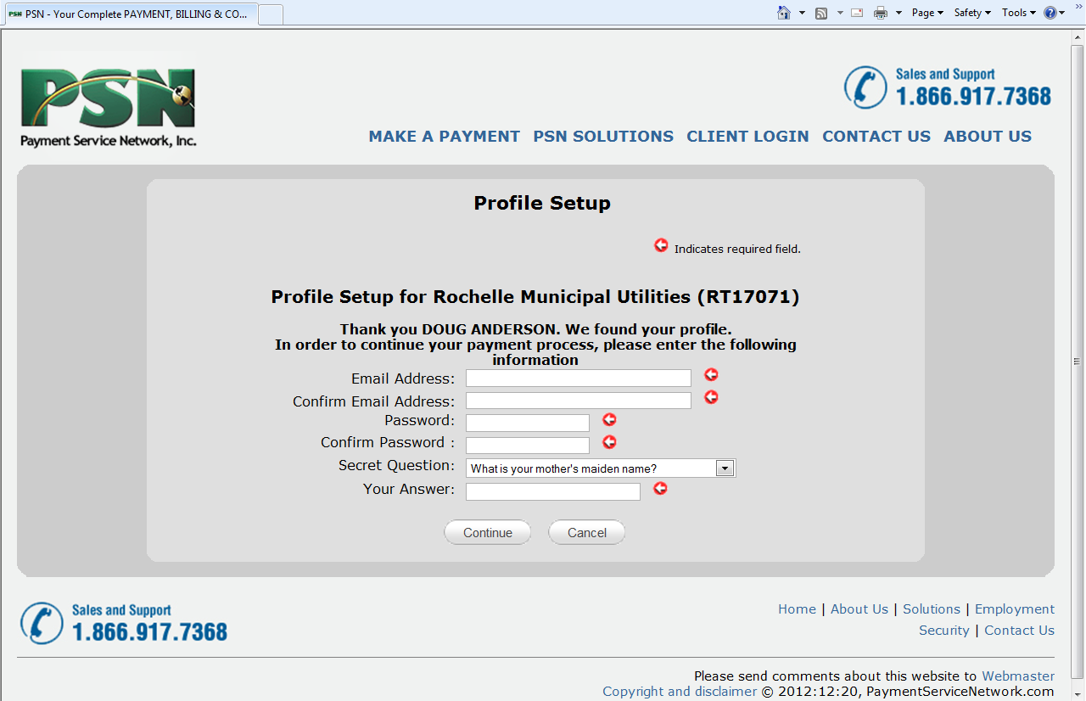
Creating the customer profile
Customer will now register by creating a profile by providing:
Email address
Password
Secret question
This information is their login info to make future pay-ments just a 3-step process.
Your Name Appears Here
xxxxx
Customer Name
Additional information can be stored (as shown later)

Slide 9
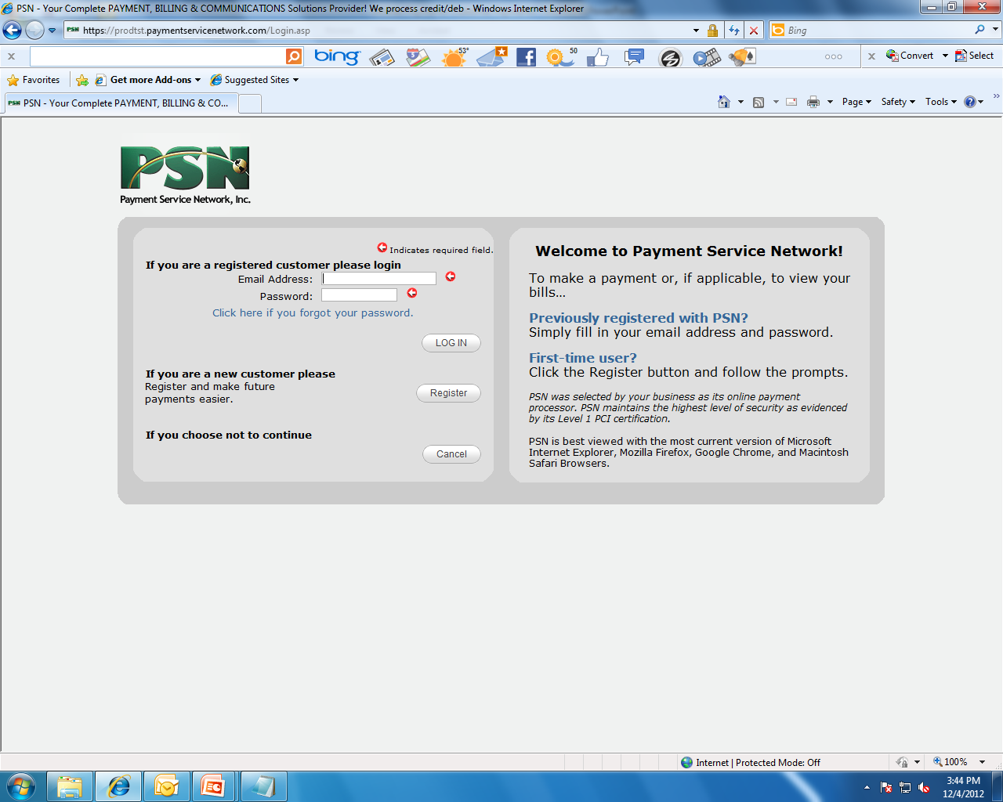
Returning customers
The next time your customer logs into make a payment, they simply enter the login information they previously set up (email address and password).

Slide 10
PART 2: Customer registration for non-integrated payment accounts
Please keep in mind, that because PSN can customize its services for each business, there may be variances in the slides and explanations shown. If you have any questions as to how your customers pay, contact your Service Account Manager.

Slide 11
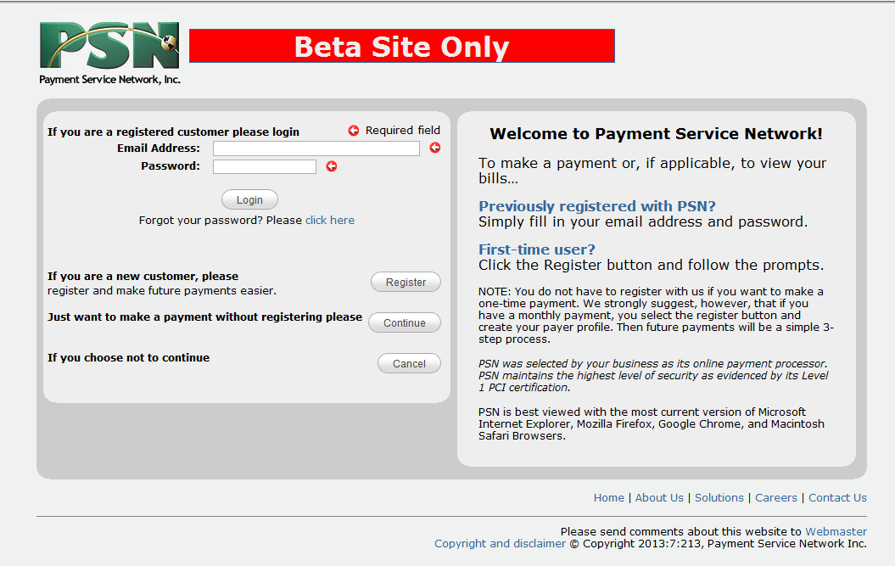
Registration
Customer should select Register the first time they go online to make a payment.
While we recommend customers register to make payments in order to make future payments just 3 steps, they can opt to make a payment without registering. They would select the Continue button. No information is stored and therefore each time they make a payment, they will go through a longer process.

Slide 12
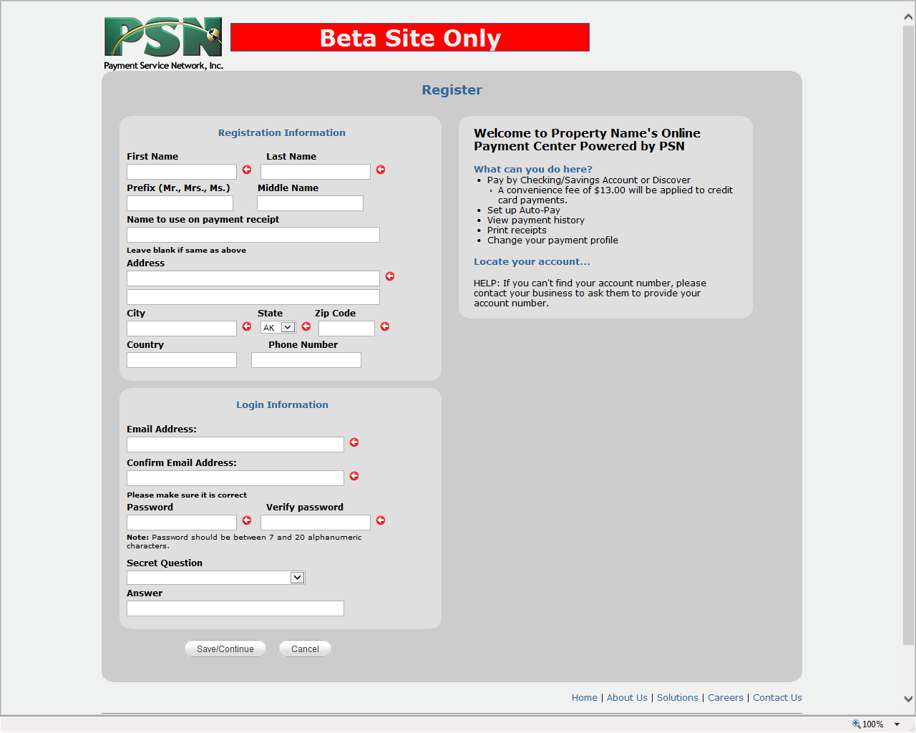
Registration
Customer will enter:
Their contact information
Set up their login credentials
Welcome to “Your Company Name” Online Payment Center Powered by PSN

Slide 13
Returning customers
The next time your “registered” customer logs into make a payment, they simply enter the login information they previously set up (email address and password).

Slide 14
PART 3: The customer payment experience
Please keep in mind, that because PSN can customize its services for each business, there may be variances in the slides and explanations shown. If you have any questions as to how your customers pay, contact your Service Account Manager.

Slide 15
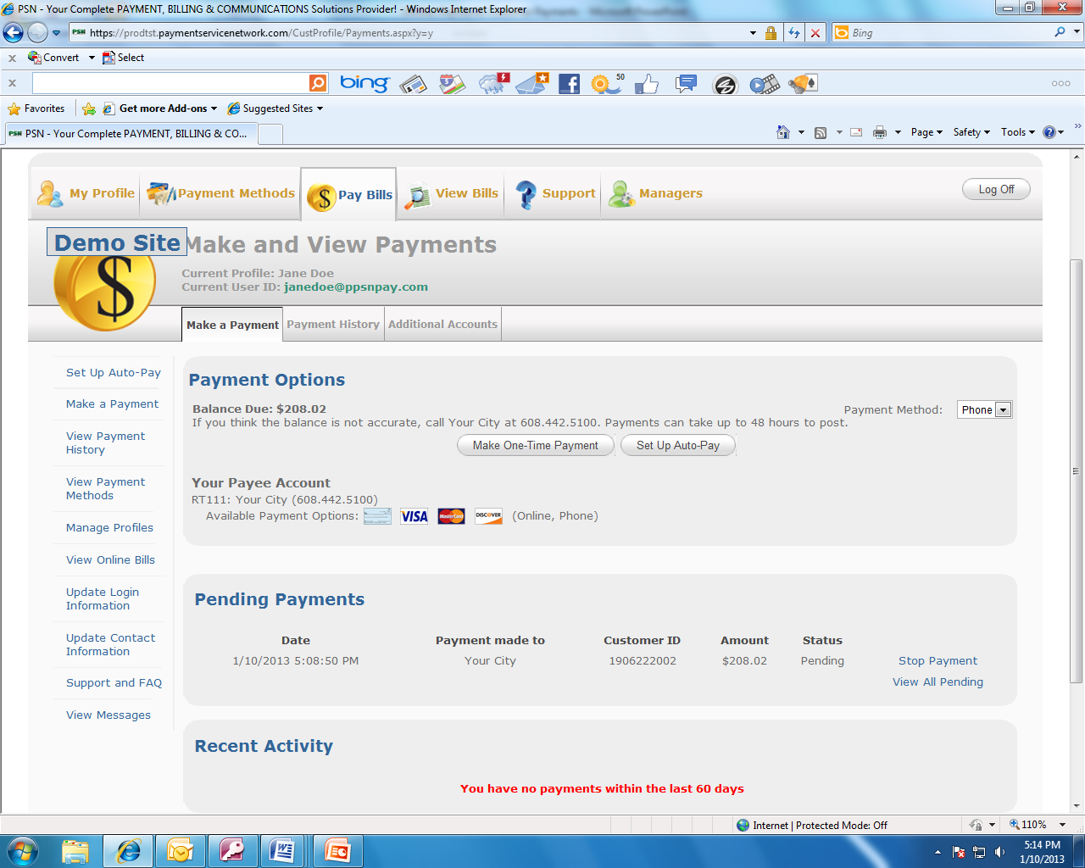
Making a one-time payment
STEP 1.
Customer selects to make a one-time payment
If provided to PSN, the amount due appears here
Only displays options you offer
Pending, problem and recent payments appear here

Slide 16
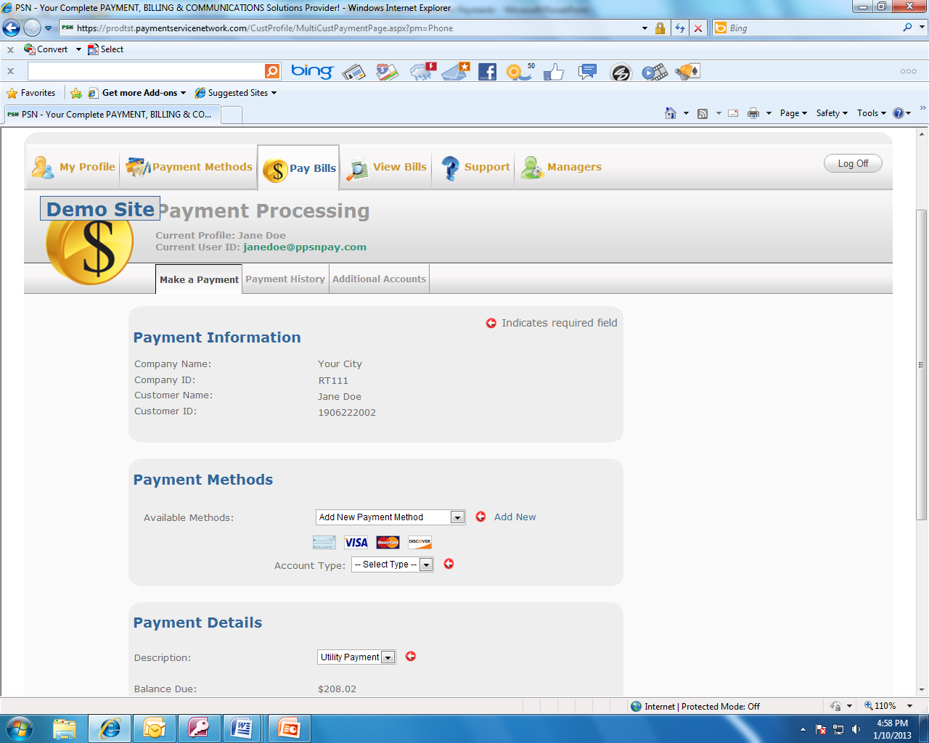
Making a one-time payment
STEP 2.
Customer makes payment
Smart display: Customer doesn’t need to do anything in this section
Smart display of payment methods that you have authorized (check, VISA, etc.). Customer selects type of account and completes the information requested.
Smart display
Customer inputs the amount of payment and the payment date; then selects “Continue.”

Slide 17
Making a one-time payment
STEP 3.
Customer confirms and submits payment

Slide 18
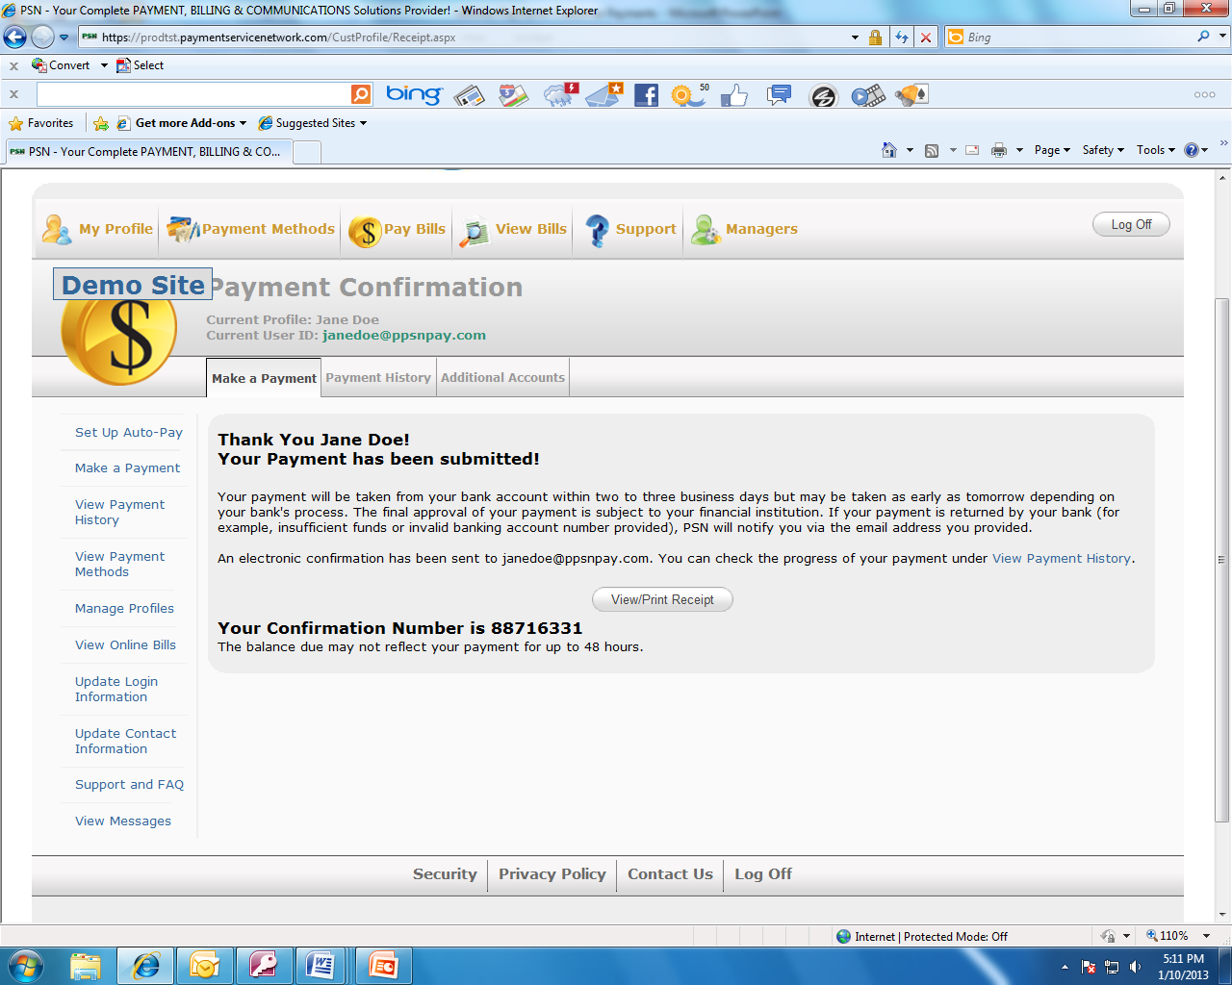
Making a one-time payment
Customer can view or print a receipt

Slide 19
Setting up Auto-Pay
STEP 1.
Customer selects Set up Auto-Pay
If provided to PSN, the amount due appears here
Only displays options you offer
Pending, problem and recent payments appear here

Slide 20
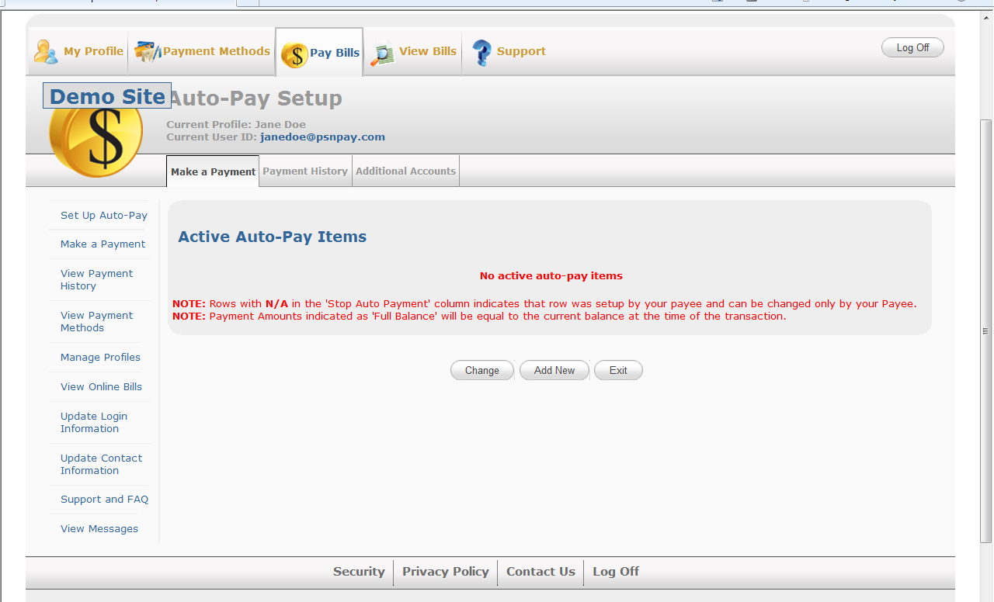
Setting up Auto-Pay
STEP 2.
Customer selects Add New. (Customer can also change an existing Auto-Pay, such as changing a payment method or the date of the payment.)

Slide 21
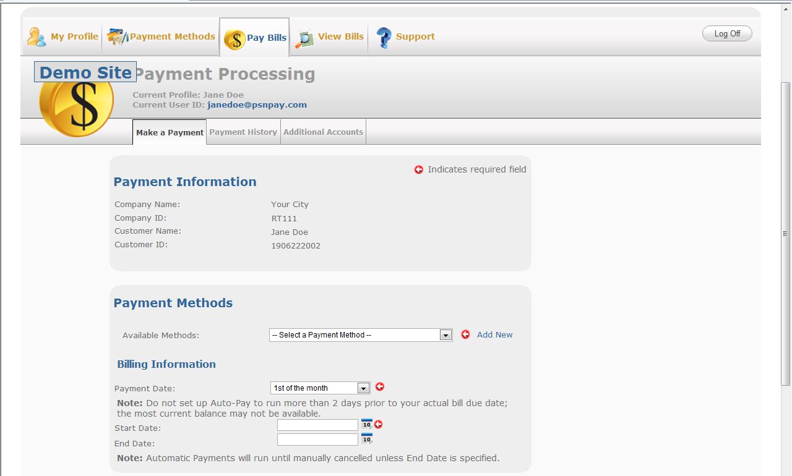
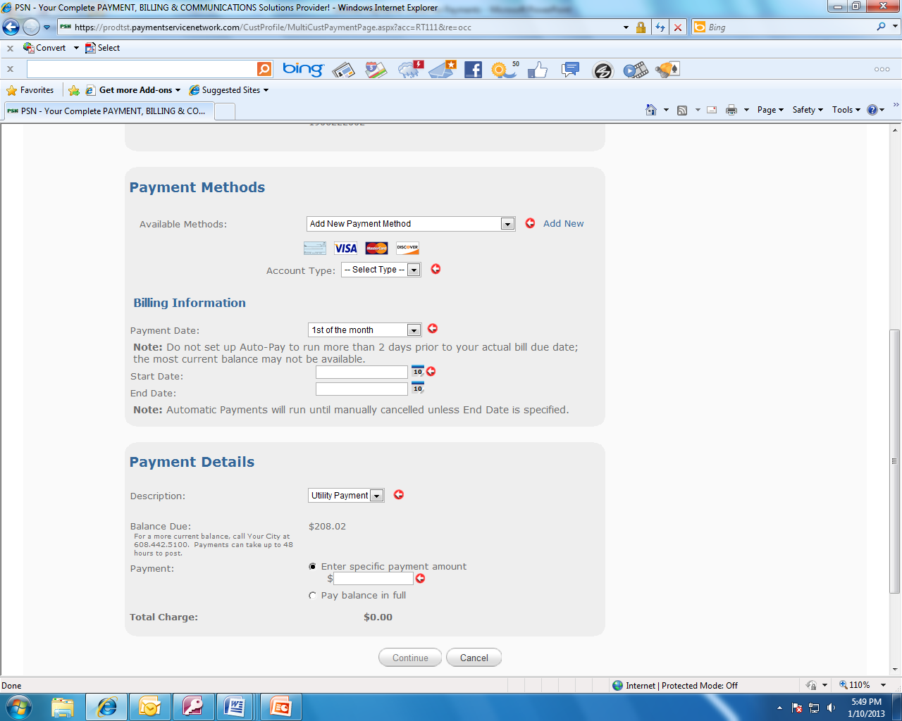
Setting up Auto-Pay
STEP 3.
Set up payment information.
Smart display: Customer doesn’t need to do anything in this section
Customer adds a new payment method or selects one they have previously set up.
Select a day of the month to run the payment
Click on the calendar to select the first payment date. It is optional as to whether they put in an end date
They can select to specify a payment amount or simply check the box to pay the balance in full for each bill (if the balance is passed to PSN)

Slide 22
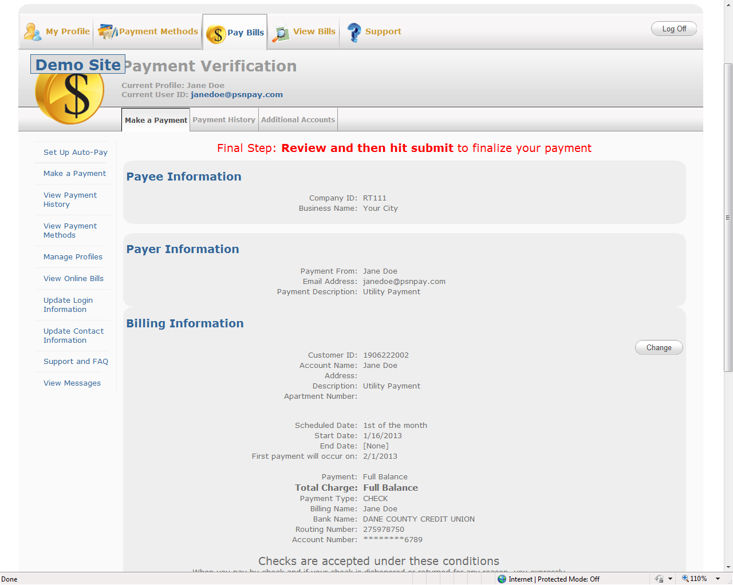
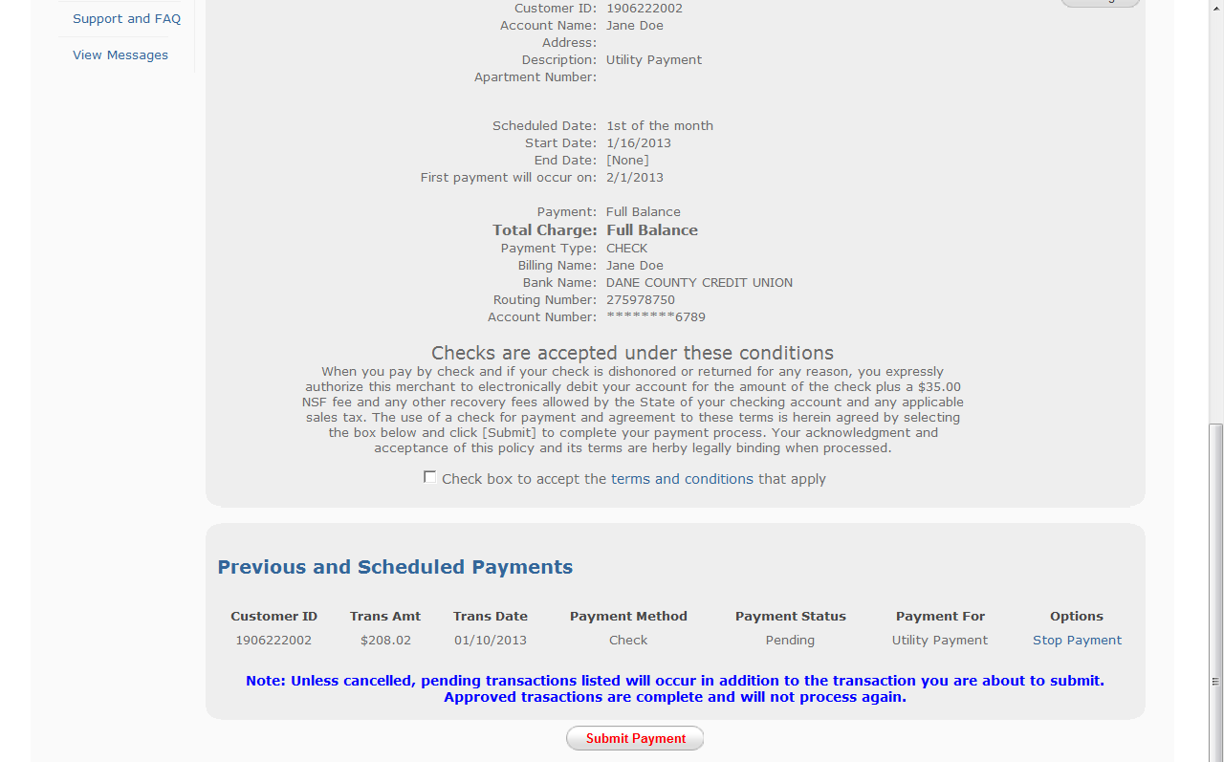
Setting up Auto-Pay
STEP 4.
Customer verifies all of the information and submits payment.
To make sure an Auto-Payment is not duplicating an already scheduled one-time payment, we display scheduled payments which can be stopped.

Slide 23
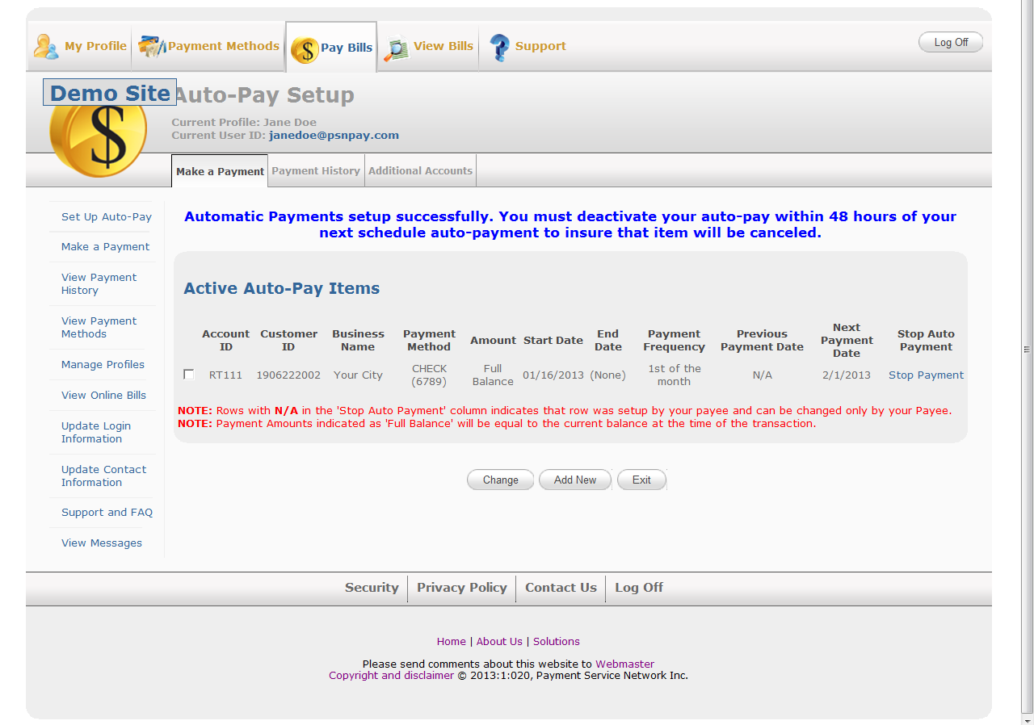
Setting up Auto-Pay
Verification that Auto-Pay has been set up correctly

Slide 24
PART 4: The customer profile
Please keep in mind, that because PSN can customize its services for each business, there may be variances in the slides and explanations shown. If you have any questions as to how your customers pay, contact your Service Account Manager.

Slide 25
The customer profile
This is where your customers manage their PSN accounts. Four tabs allow for:
Updating contact info
Changing login info
Grouping accounts (for those who pay more than one bill)
Opting out of or into paper bills, if offered

Slide 26
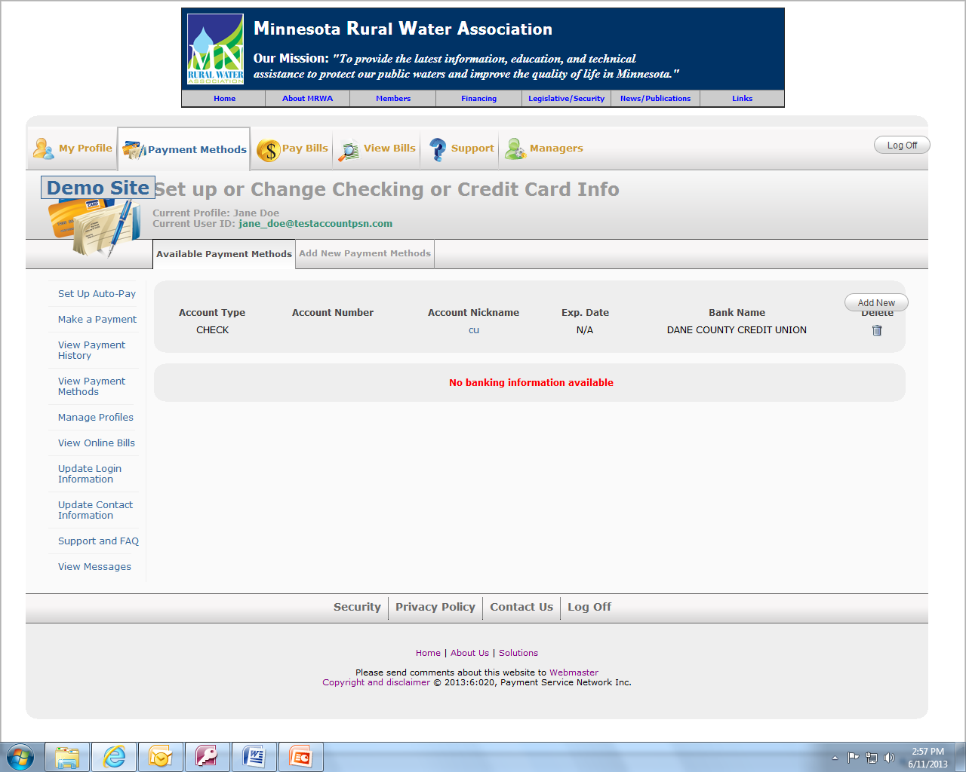
Managing payment methods
This is where your customers manage their payment methods:
Add new checking, savings, credit card (as applicable)
Delete accounts
Change account numbers

Slide 27
Support for your customers
We support your customers:
Number for phone payments
Submit a ticket to PSN
View FAQs
Number for the PSN Call Center
Submit a ticket to your business, if offered

Slide 28
PART 5: Quick Pay
Please keep in mind, that because PSN can customize its services for each business, there may be variances in the slides and explanations shown. If you have any questions as to how your customers pay, contact your Service Account Manager.

Slide 29
Customer authentication
STEP 1.
Customer enters account number and last name
When the account is found, customer selects Make a One-Time Payment

Slide 30
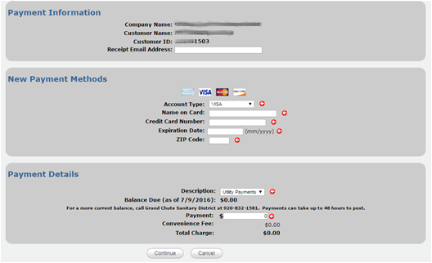
Making the payment
STEP 2.
Customer enters payment method and amount
Balance due is displayed if shared with PSN

Slide 31
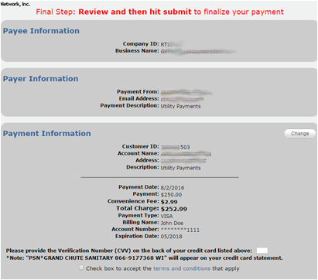
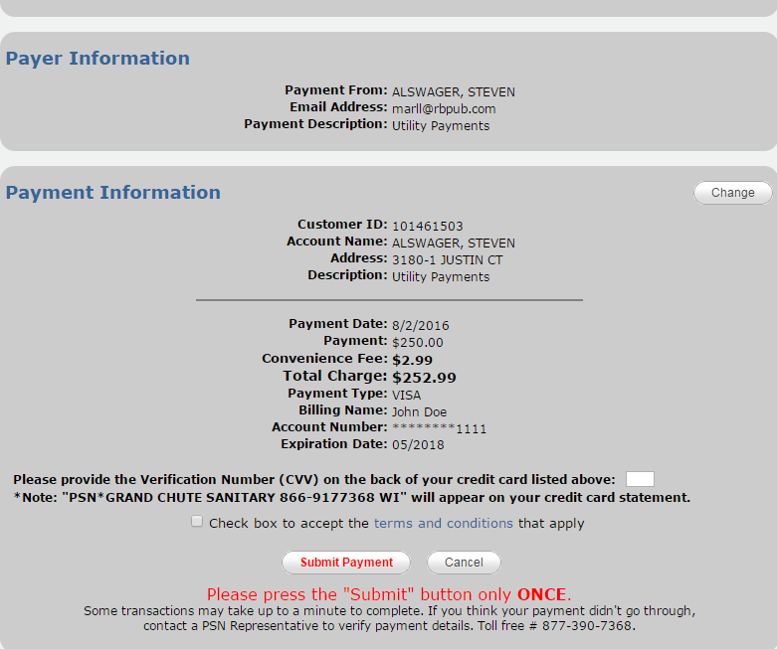
Payment confirmation
STEP 3.
Customer confirms info and submits payment.
An email is sent to the customer to confirm the payment

Slide 32
Thank You
Contact your Service Account Manager for any additional information.
Hours: 8am-5pm CST
Voice: 866.917.7368
Email: CustomerService@PaymentServiceNetwork.com

