Slide 1
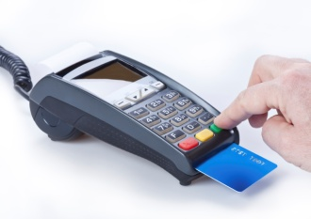
and Your Business Day
Simplifying Your Customer’s Life
Yes, it’s possible!
You can advance the slide anytime after the arrow appears

Slide 2
Your customers…
I don’t trust the Internet; can I pay by phone?
Look, I’m not changing how I pay, I’ll always mail a check
I like to come into your office to pay; it gets me out of the house
I have to work when your office is open and the payment is due today
I have to pay online; I don’t even have a checkbook
Can’t you take a credit card?
I have to pay in cash

Slide 3
Your staff
The phones were so busy today, I couldn’t do those reports. People always misplace their bills and call us for balances on the due date.
We’re going to have to add more staff to handle all of these hard-to-reconcile checks coming from people’s banks
I didn’t finish the project because I spent all day taking counter payments
Management is always pushing to lower costs; where else can I cut?
Can’t reconciliation be simplified; I had to run five different reports
PSN is here to help

Slide 4
A bit about PSN
Pioneer in industry, being one of the first to provide true eServices, SaaS and integrating with business accounting software
In business since 1999 under the same leadership
Specialize in ePayments serving more than 3,000 US business accounts
From inception, mission has been to allow payers to pay by whatever means they want while streamlining the remittance process for businesses

Slide 5
Services in a nutshell
ePayments
We accept all methods of payment through all means
eBills
We provide online bills with easy paper-bill opt out
eCommunications
We keep you and your customers up to date on all payment and billing activity
Consolidate
All payments coming from anywhere and everywhere are channeled through PSN for ONE deposit, ONE reconciliation
Automate
All payments can automatically post to your software (as long as your software can import and export data)

Slide 6
Online
Payments
eBills
Balance Due
Payment Hisotry
Billing History
More

Slide 7
Mobile app
Comes standard with online payments
Payment history
Change password
Add / delete payment methods
Customized apps are also available

Slide 8
Text
Once your customer signs up for text payments, they will receive a text and press 1 to make the payment!

Slide 9
Automated
Phone
Hear balance due
Add / delete payment methods
Spanish and English
Auto recognition after 1st call

Slide 10
PSN Call Center
English and Spanish
365 days a year
Extended hours

Slide 11
Counter Service
Credit Card Terminal
Virtual Terminal

Slide 12
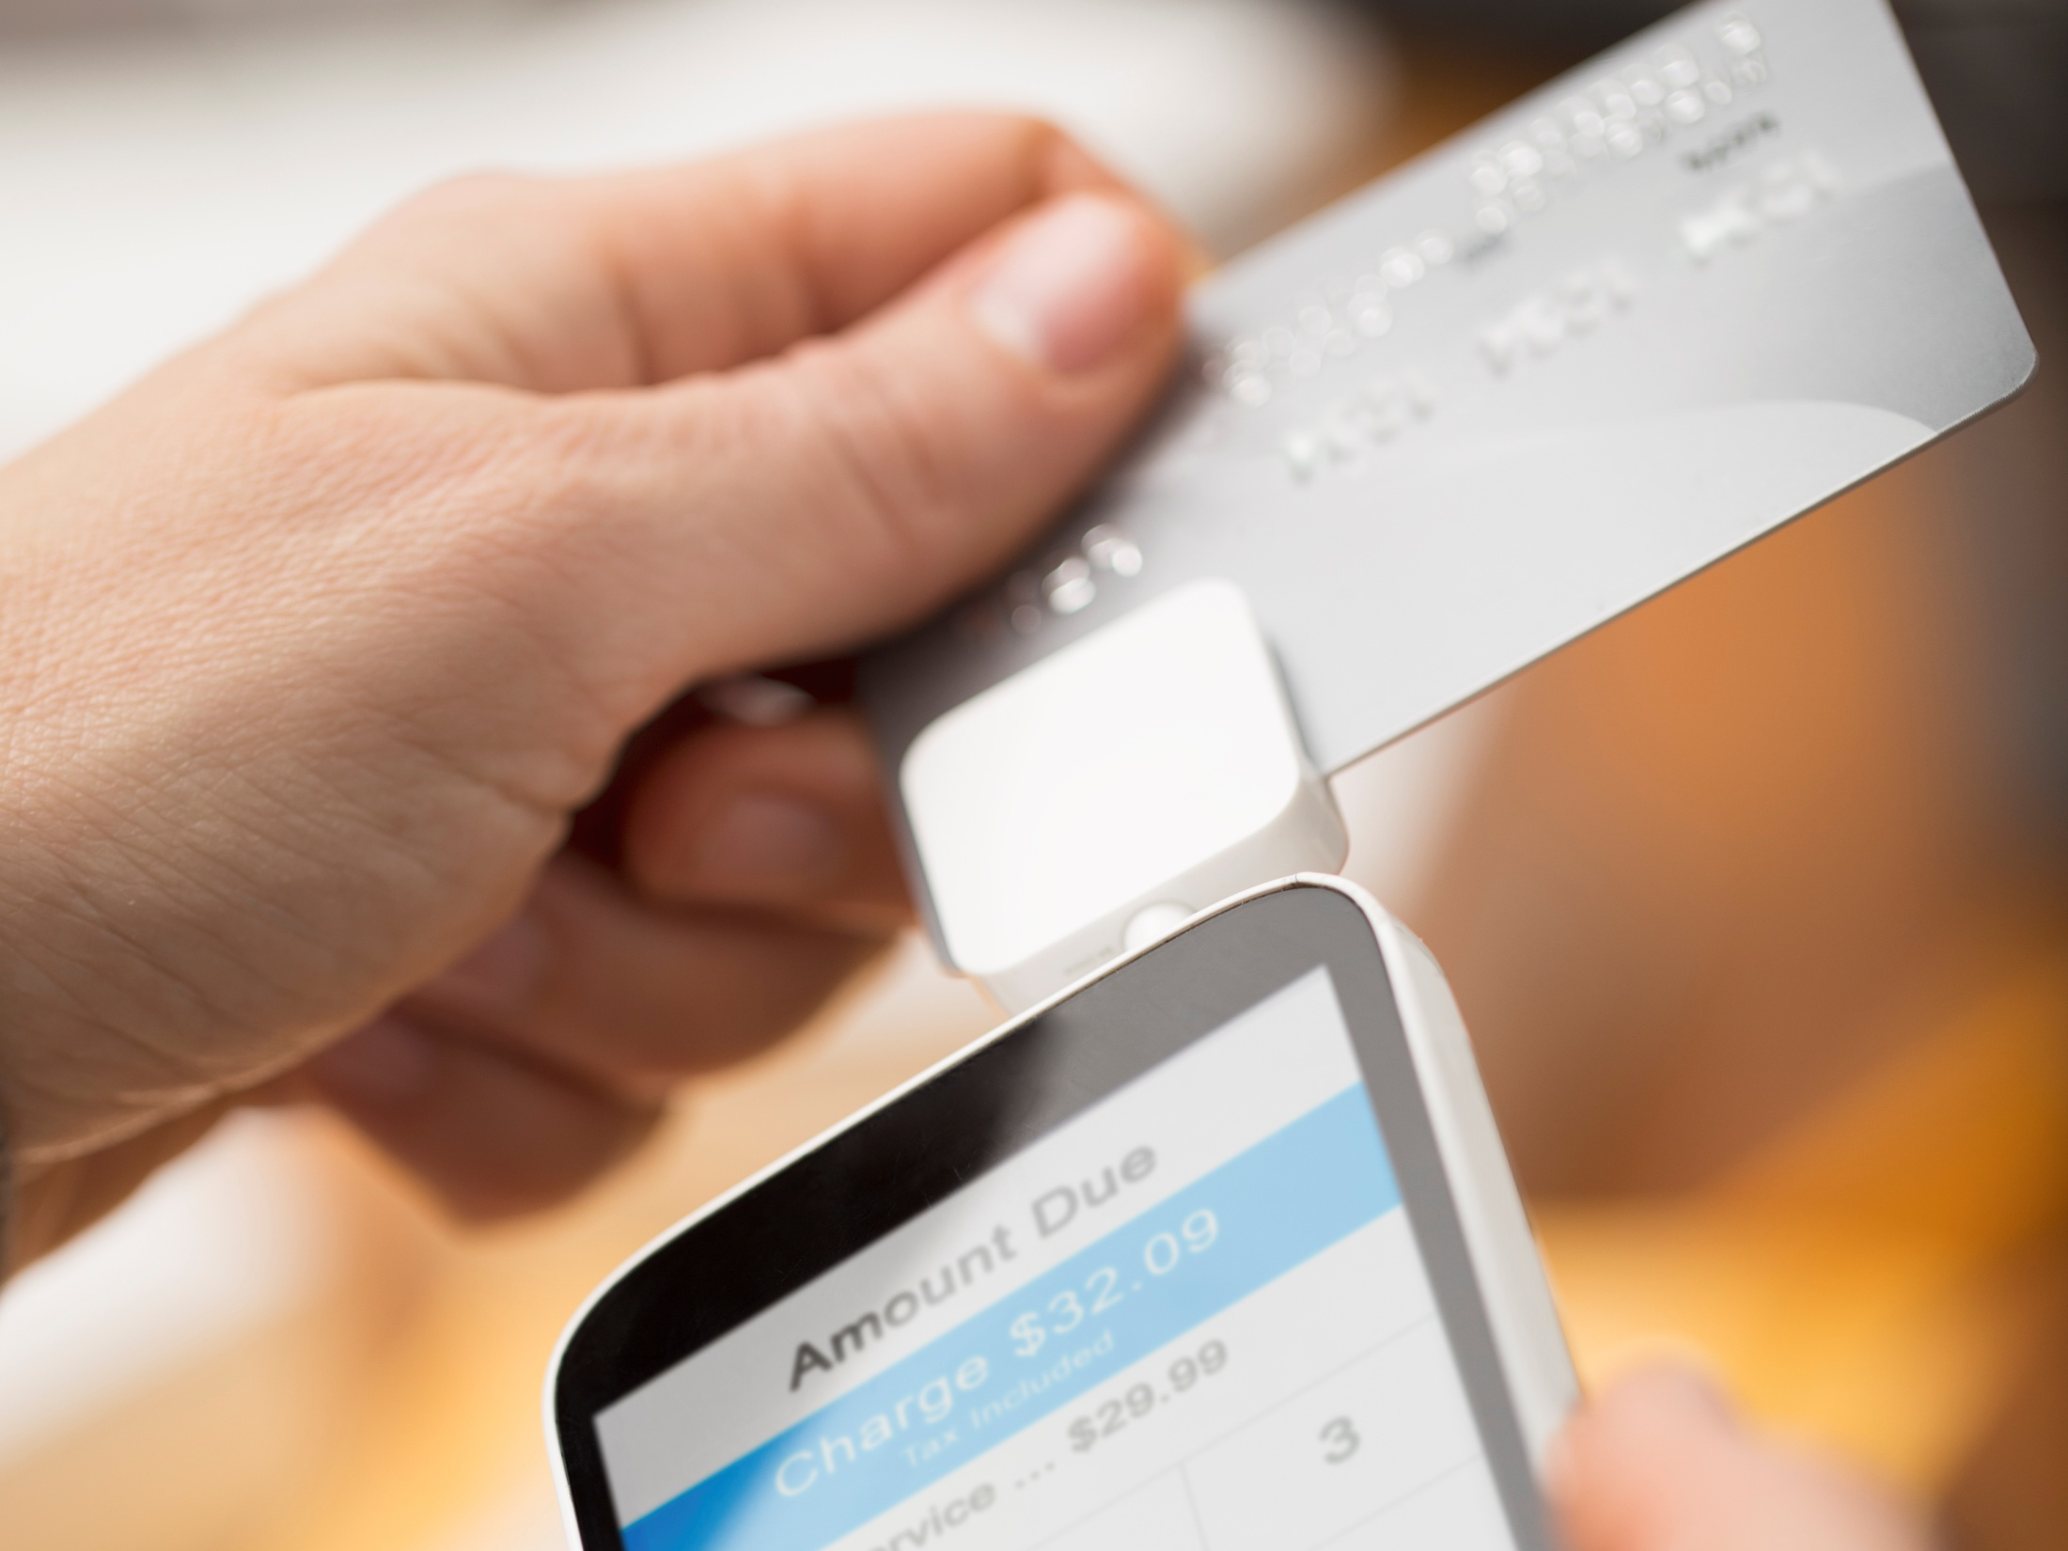
Field Payment
Remote payments
View history
View balance due
Set up customer account

Slide 13
Cash Payment Locations
Convert cash to ePayments
Remove risk from office
Convenient customer locations

Slide 14
Kiosk
Indoor, outdoor, through-the-wall
Credit cards, eChecks, eSavings, cash options

Slide 15
Bank’s Bill Payment Service
Converts hard-to-reconcile bank-issued checks to ePayments

Slide 16
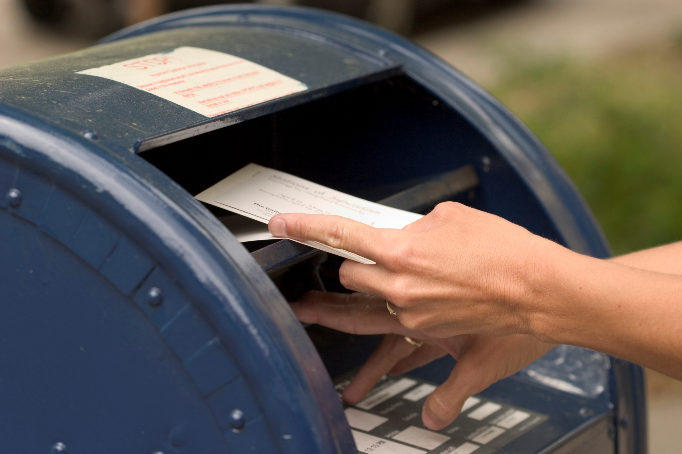
Mailed
Scan paper checks
Automatically posts to software

Slide 17
Lockbox
Locations nationwide
Auto-post to software

Slide 18
Quick Pay
One-time payment without registering
Auto-posts to your software

Slide 19
Post customer billing file to PSN FTP site
PSN creates PDF bills to look like paper bill
PSN posts to payer portal and archives for 24 months
eBills
24 month archive
Paper bill opt-out
Email notices for new bill, coming due, past due

Slide 20
Auto-Call Messaging
Simply upload message and list, set date / time
Great for late notices and maintenance

Slide 21
Customization
Beyond your solutions, PSN can customize
• Payer portal • Automated phone • Mobile app

Slide 22
No matter where they pay
Online, Mobile, Text
Customers' Bank Bill-Pay Systems
Online,
Mobile, Text
Customer’s Bank Bill Pay System
Automated Phone (IVR)
Automated Phone (IVR)
Mobile Field Payments
Mobile Field Payments
Cash Payment Locations
Swipe/ EMV Machines
Cash Payment Locations
Swipe/ EMV Machines
PSN Call Center
Auto-Post Check Scanning
PSN Call Center
Auto-Post Check Scanning
PSN Web-based System
PSN Web-based System
Entered by Your Staff
Lockbox
Entered by Your Staff
Lockbox
Consolidate for one deposit
Your Software

Slide 23
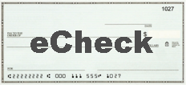
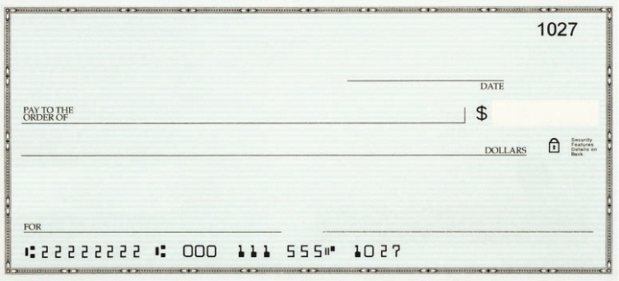
No matter how they pay
Online, Mobile, Text
Customers' Bank Bill-Pay Systems
Automated Phone (IVR)
Field Payments
Cash Payment Locations
Swipe/ EMV Machines
PSN Call Center
Auto-Post Check Scanning
PSN Web-based System
City Staff Entered
Lockbox
Consolidate for one deposit
Your Software

Slide 24
Each department or payment account can select what is best for it
Online, Mobile, Text
Customers' Bank Bill-Pay Systems
Automated Phone (IVR)
Field Payments
Cash Payment Locations
Swipe/ EMV Machines
PSN Call Center
Auto-Post Check Scanning
PSN Web-based System
City Staff Entered
Lockbox

Slide 25
To “turn on” additional services, contact your Service Account Manager

