Slide 1
How to Do Month-end Reconciliation
Use the arrows on your keypad to move forward (→) or go back (←) to a slide.
A next arrow will appear when the slide is complete and you can advance at any time to the next slide.
NEXT

Slide 2
Reconciling payments & deposits
PSN has created reports that make reconciling payments and deposits easy
The complete reports are available by the 5th day of the month for the previous month (for example, January is available on February 5 and thereafter)
Reports are in your PSN Account Management Center (AMC)
Here’s how it works

Slide 3
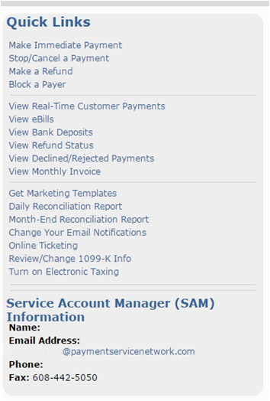
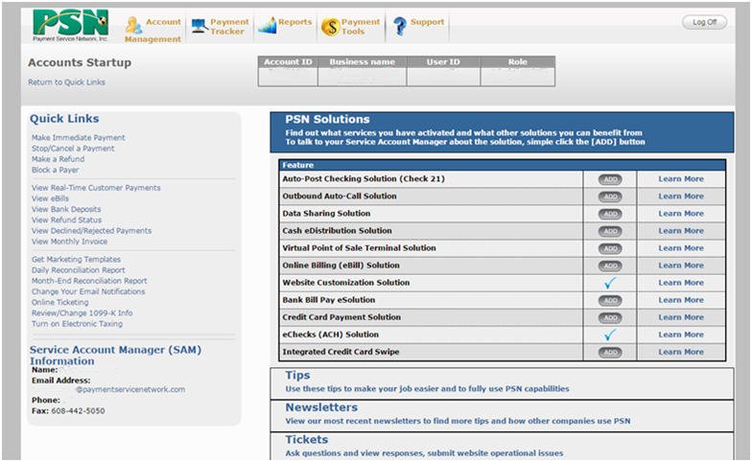
Finding the reports in your AMC
Month-End Reconciliation
NEXT

Slide 4
Select the criteria for the report
Select the year
Select the month
Select summarized or detail
Select file format
Generate Statement
Report Type:
Summarized = lists daily information (recommended)
Detailed = lists all payments
File Format:
PDF (recommended)
TIFF
HTML
RTF
Excel
NEXT

Slide 5
The report
The summarized report will include:
Deposits/Withdrawals for each day of the month—deposits of payments and withdrawals of fees (if applicable), refunds, reversals, etc.
Disputed Payments—credit card charges disputed by the payer (funds are withdrawn from your account)
Rejected/Declined—generally NSF and “no account” payments which may be withdrawn from your account if previously deposited
Credits/Refunds—money that you have returned to the payer by withdrawing funds from your account
Integrated Software Downloads—if your software is integrated with PSN, it will list each day’s payments posting
Deposit Exceptions—payments which post to your software but were not deposited to your account until the next month (generally payments made on the last couple of days of the month). NOTE: PSN fees are withdrawn on the day the payment was made.
Invoice—monies withdrawn from your account for PSN fees, as applicable
If you select a detailed report, it will itemize all transactions that occurred during that month.
NEXT

Slide 6
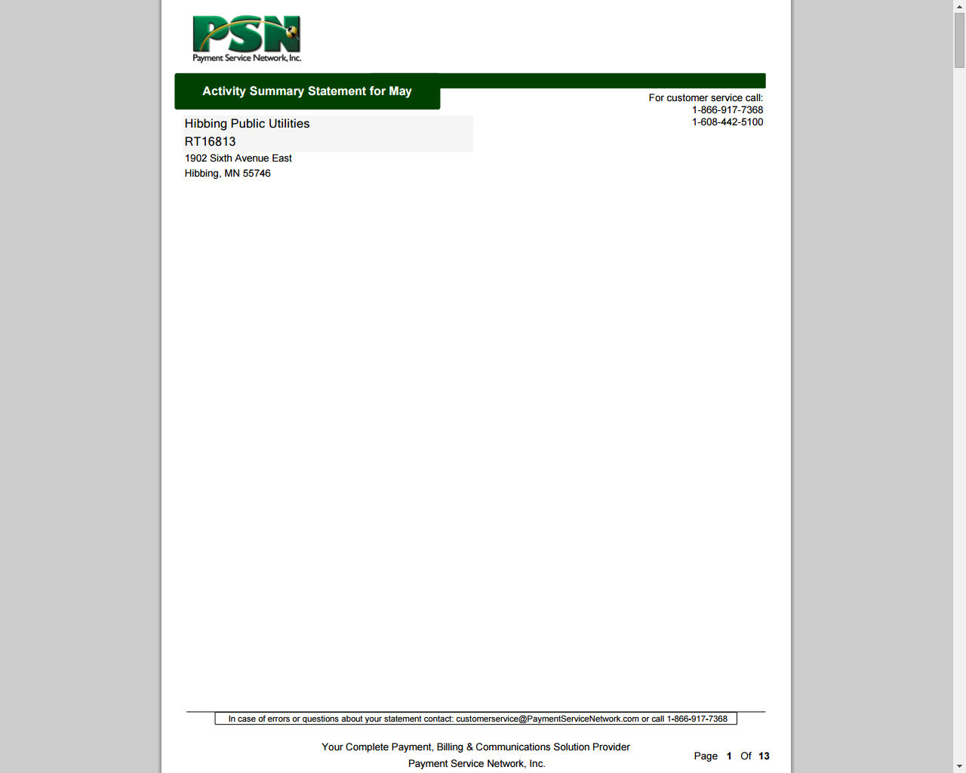
The report: Header page
The first page is a header page; make sure it is the right date range
Your Company Name
PSN Account Number RTxxxxx
Address
City, State ZIP
NEXT

Slide 7
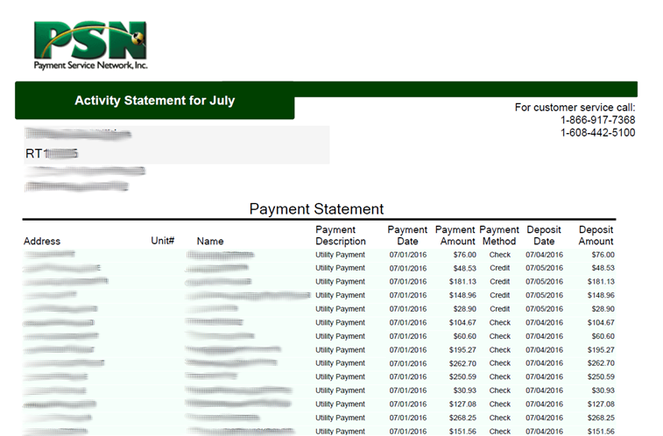
Payments
A listing of all payments for the time period will be listed.
The last page will give totals.
NEXT

Slide 8
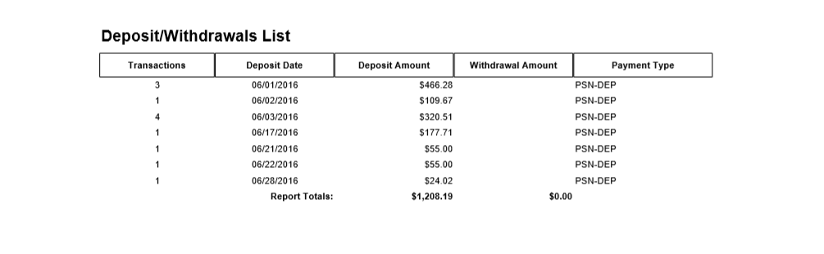
The report: Deposits summary
Number of transactions for that day
Day
Total deposits for day
Chargebacks & refunds withdrawn
Type of transaction
Monthly totals
TERMS
Chargeback = Funds withdrawn from your bank because an ACH (check/savings) payment was rejected by the bank. Since PSN had already deposited the funds in your bank, we are withdrawing them.
Refunds = Funds that you are giving back to your customers (e.g., a customer overpaid, paid two times—electronically & paper check). PSN withdraws from your fund and “gives back” to your customer electronically.
NEXT

Slide 9
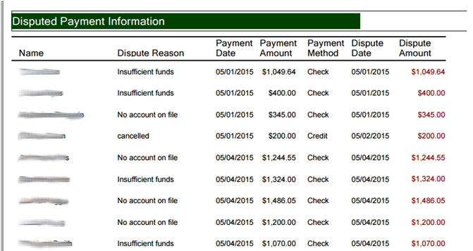
The report: Disputed payments
Customer/ resident name
Reason for dispute
Date payment was made
Payment amount
Payment method
Date it was disputed
Disputed amount
NEXT

Slide 10
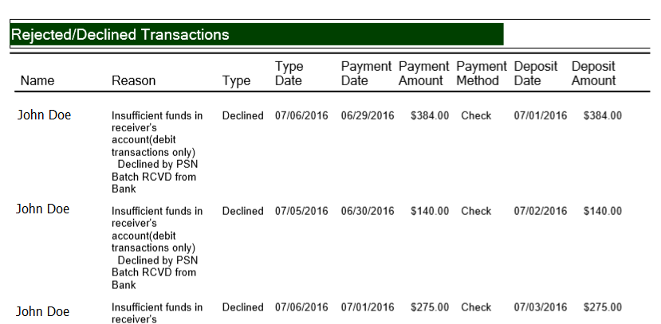
The report: Rejected/declined
Customer/ resident name
Specific reason
Whether it was rejected or declined
Date, if PSN deposited funds to you. If so, the funds will be withdrawn
Declined date
Date payment was made
Amount of payment
Method of payment
Deposit amount; amount that was/will be withdrawn from your account
TERMS
Rejected = Generally means the account doesn’t exist
Declined = Generally means insufficient funds
If the item is in red, indicates the funds were deposited into your account and PSN has issued a chargeback to withdraw the funds.
NEXT

Slide 11
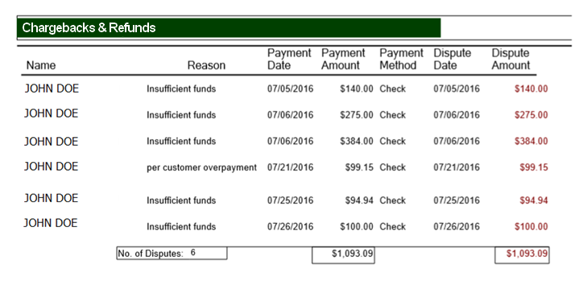
The report: Chargebacks & Refunds
Customer/ resident name
Reason for dispute
Payment date
Payment amount
Payment Method
Date of Dispute
Disputed amount
TERMS
Chargeback = Funds withdrawn from your bank because an ACH (check/savings) payment was rejected by the bank. Since PSN had already deposited the funds in your bank, we are withdrawing them.
Refunds = Funds that you are giving back to your customers (e.g., a customer overpaid, paid two times—electronically & paper check). PSN withdraws from your fund and “gives back” to your customer electronically.
NEXT

Slide 12
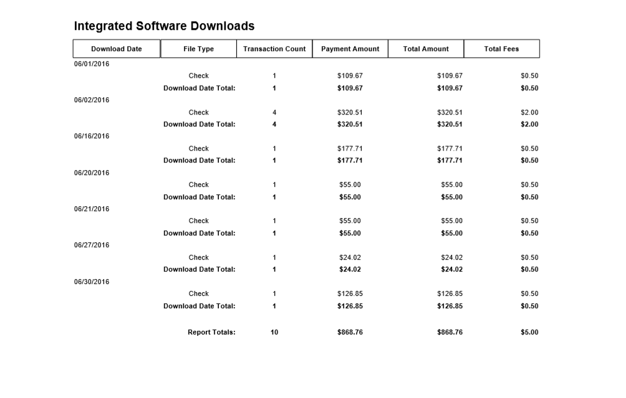
The report: Software downloads
Date
Methods of Payments
Number of Transactions
Payment Amounts
Total Amounts
Total Fees
This report displays daily payment activity that was posted to your software, if applicable. NOTE: The Total Amount column will include convenience fees if your customers are paying check/savings fees.
NEXT

Slide 13
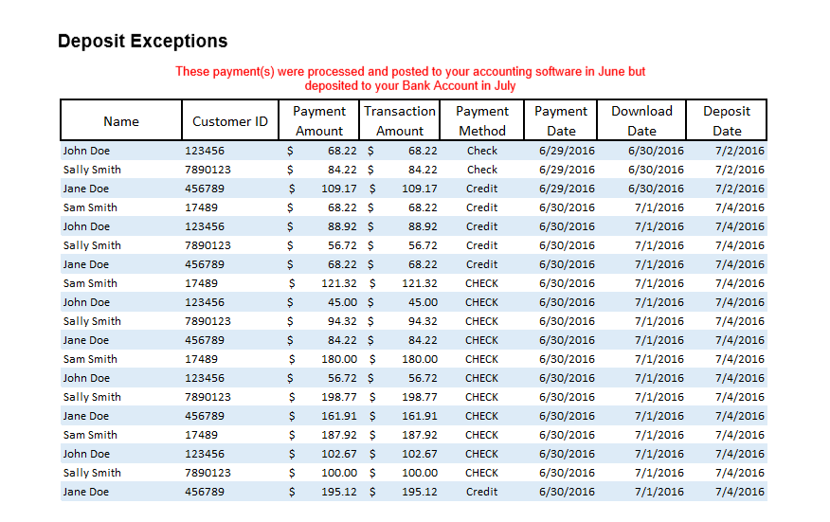
The report: Deposit exceptions
Customer/ resident name
Date of Deposit
Customer Number
Payment Amount
Transaction Amount (if fees deducted)
Payment Method
Payment Date
Downloaded to Software Date
Payments that were made at the end of the month and posted to your software but the deposit was made in the next month.
NEXT

Slide 14
The report: Your invoice
The invoice details PSN fees withdrawn from your depository account, as applicable.
NEXT

Slide 15
That’s it
Log on and try it.
If you have questions, contact your Service Account Manager.

