Slide 1
Example of a slideshow we can create for your customers

Slide 2
You Can Pay Your Water & Sewer Bills Online!
Here’s how…

Slide 3
Look at all you can do online
Make a one-time payment
Set up automatic recurring payments
View your balance due
View your bill
Print receipts and bills
Opt out of paper bills
And more…

Slide 4
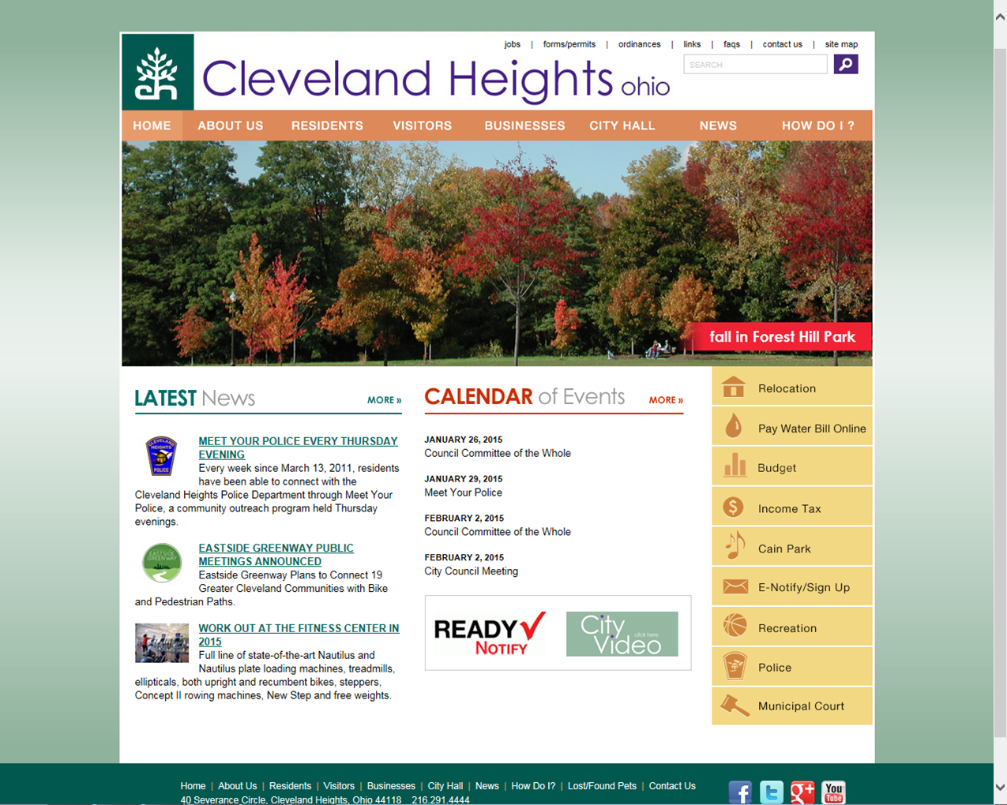
Go to “www.ClevelandHeights.com”

Slide 5
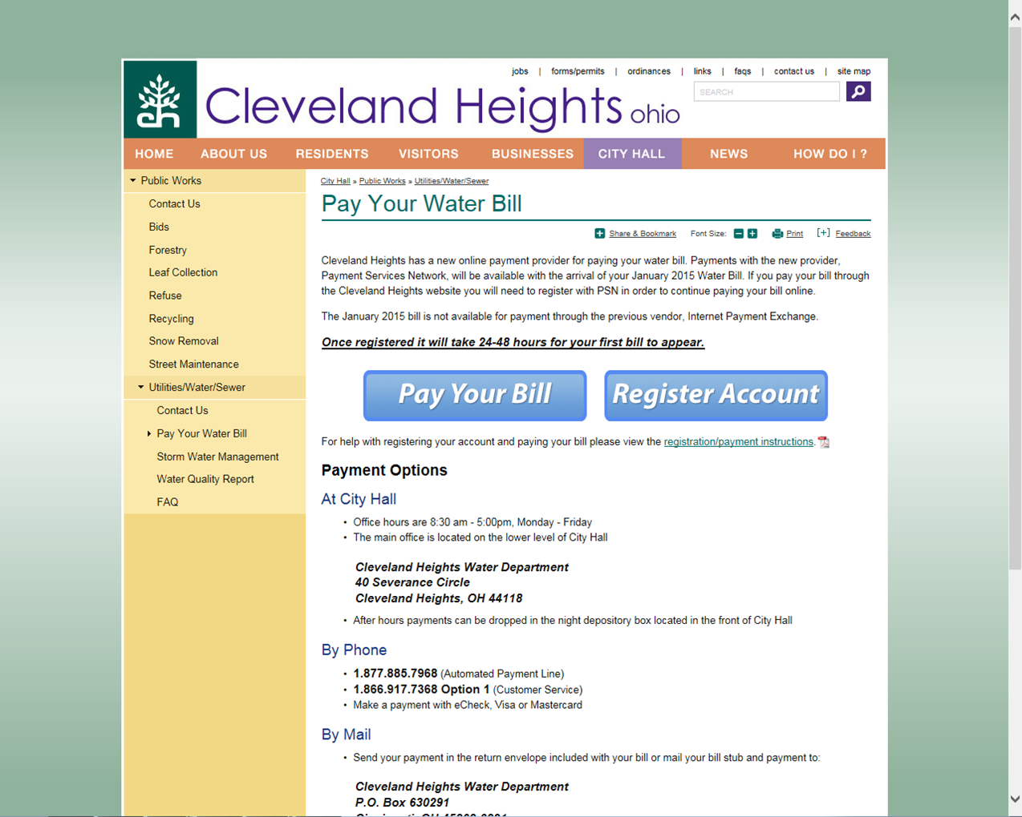
Click to do any of the following
Pay
Register
View your bill
View balance due
You’ll go to our info page

Slide 6
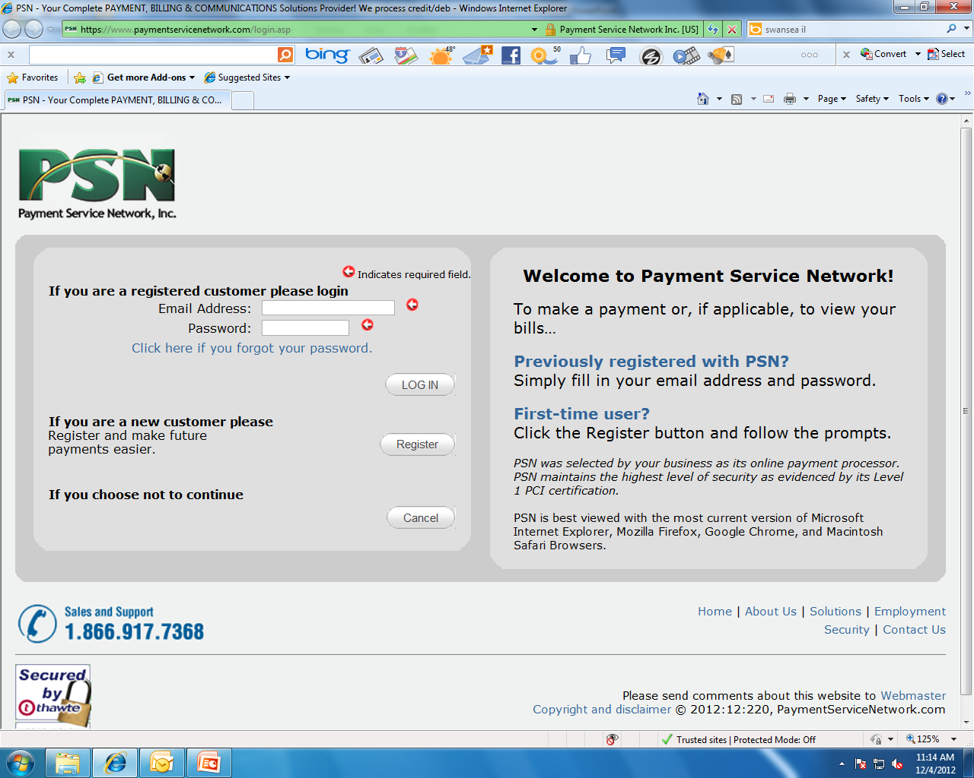
Then you’ll go to PSN
On your 1st visit…
On future visits, just log in
Select Register

Slide 7
When you register…
Setup a user id and password
Setup a payment method
Credit card
Checking or savings

Slide 8
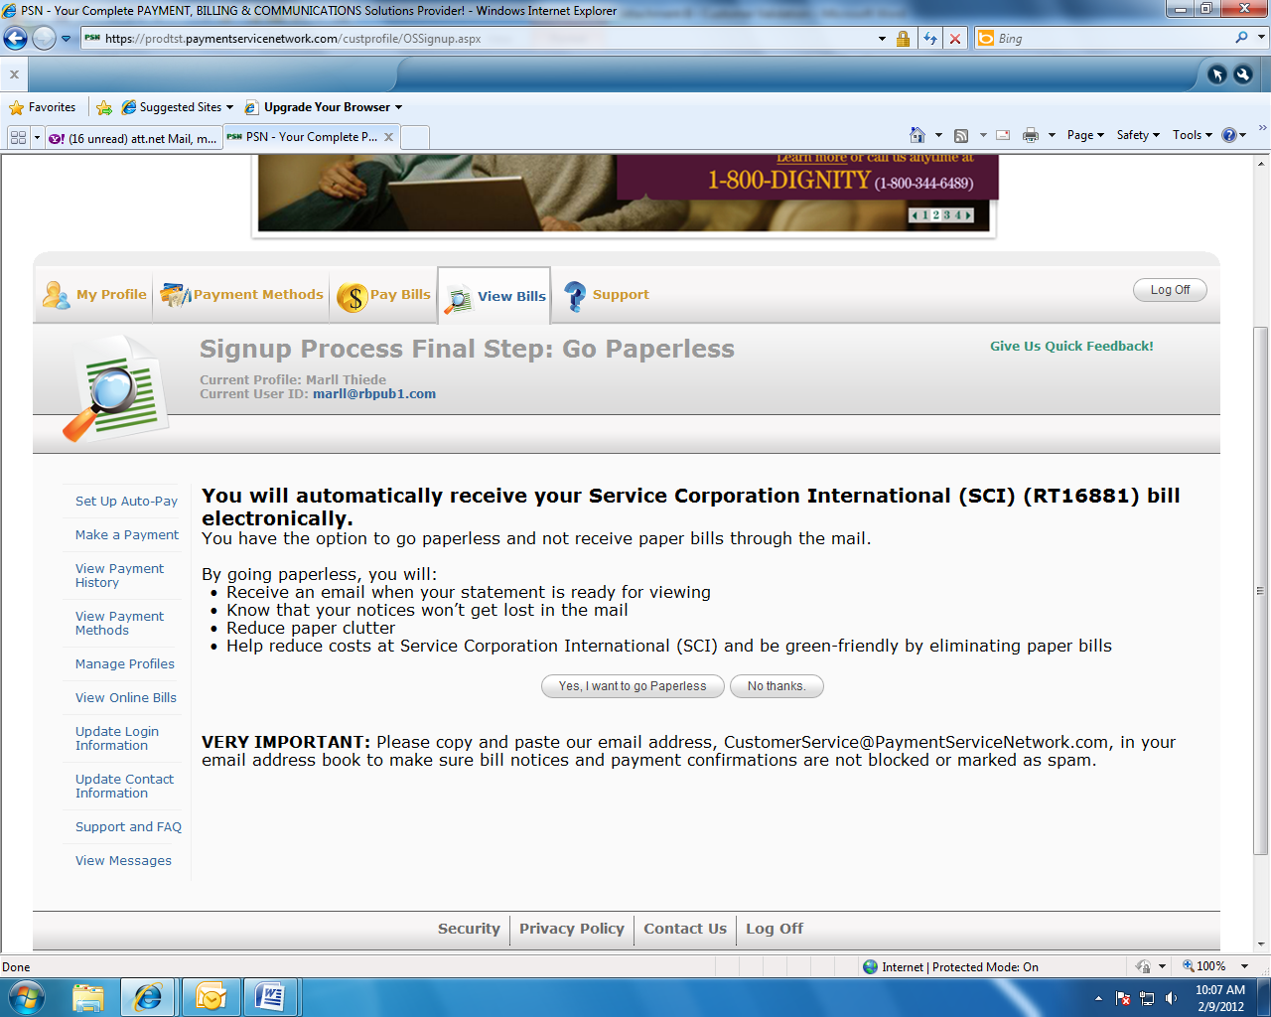
Please opt out of paper bills…
You will automatically receive your Cleveland Heights water and sewer bills electronically.

Slide 9
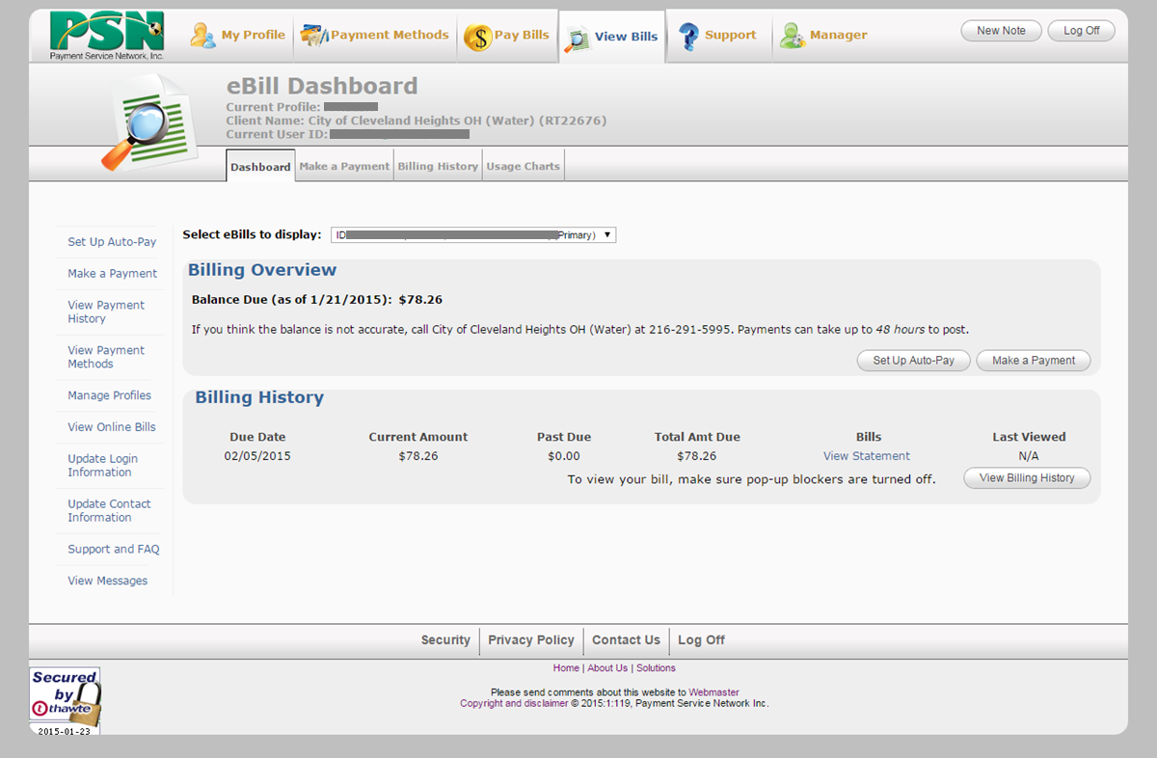
Once you have registered, it’s 3 easy steps to pay
Select which bill you want to view or pay
Water or sewer (indicated with an “S”)
Select Auto-Pay for recurring payments
Or “Make Payment” for a 1-time payment

Slide 10
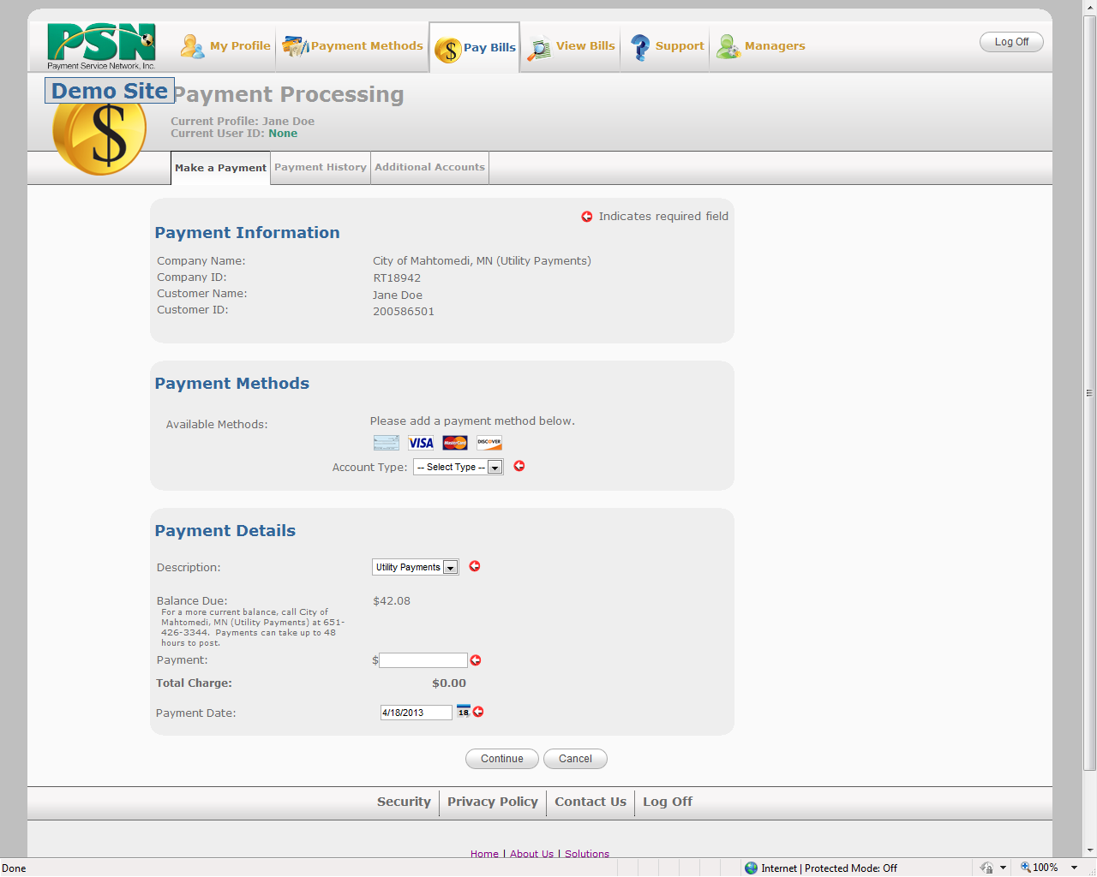
Next, make your payment
Select a payment method or set one up
Enter amount and date to be paid
Select “Continue”

Slide 11
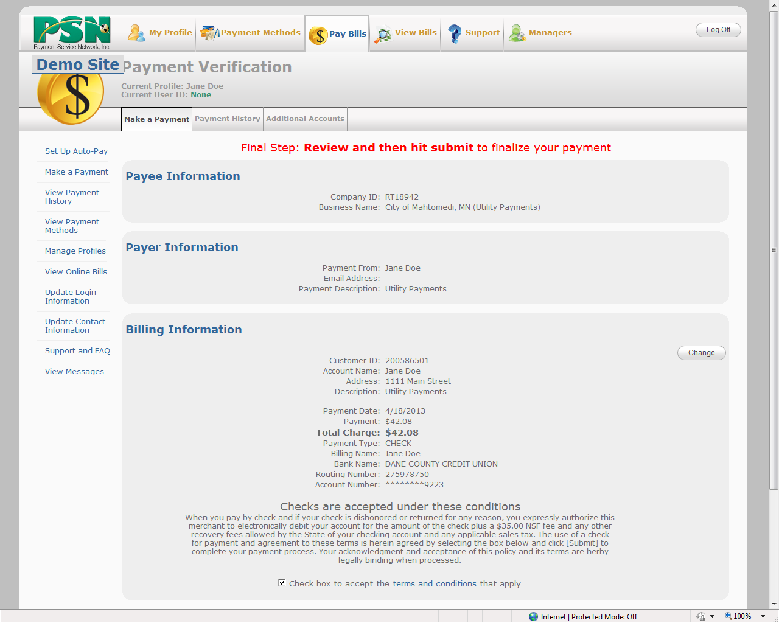
Confirm your payment
Review info
Click “Submit Payment”

Slide 12
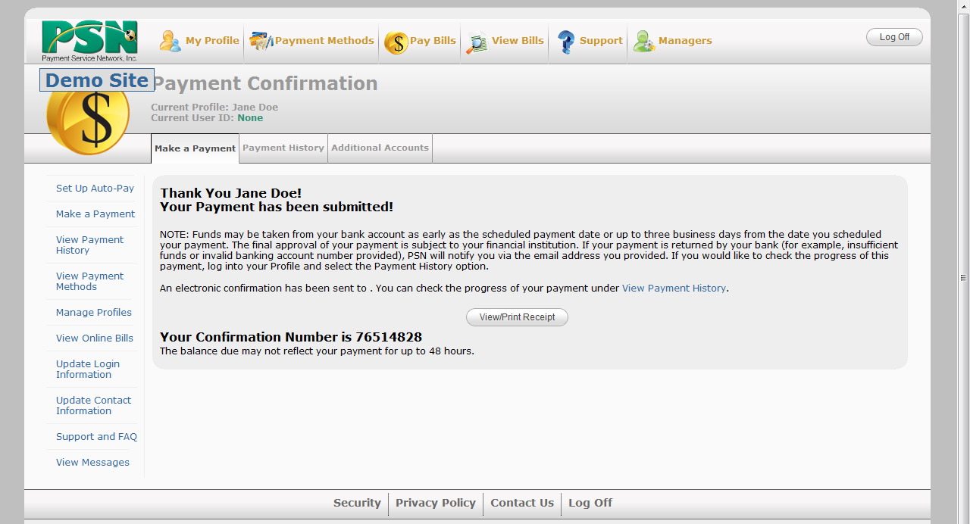
Your payment will be confirmed
We will also send you an email
Print a Receipt

Slide 13
Contact your Service Account Manager if you would like our Marketing Department to create one for your customers.

