Slide 1
PSN Daily Reconciliation

Slide 2
Daily Reconciliation of Payments
Under Quick Links, select Daily Reconciliation Report to generate a report of the number of transactions and dollar value of all transactions downloaded to your software that day.
Compare the download report to verify that the same number and amount was uploaded to your ledger.

Slide 3
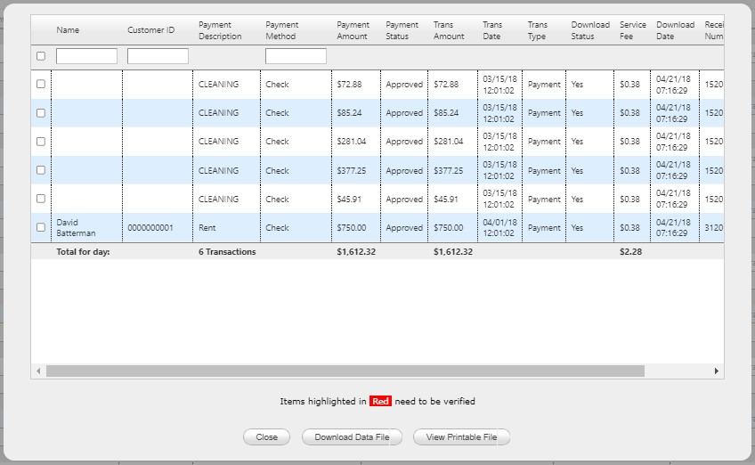
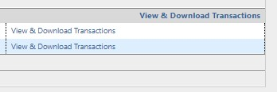
Daily Reconciliation of Payments
If you notice any discrepancies or if you want to do a more in-depth verification to compare item-by-item transactions, click View & Download Details for the date in question
For daily checks, look at the reconciliation and match reconciliation to the deposit based on your deposit delay

Slide 4
Declined/Rejected Payments
Check transactions will be posted to your software. If they are declined, you need to manually remove the posting from your software. To do this, run a report daily:
Under Quick Links, click View Declined/Rejected Payments
Click List to generate a report. It will default to transactions made in the last seven days, but you can widen the date range to look back further
Unsuccessful check transactions funded by PSN will appear in red (see below)
PSN will withdraw the amount of the unsuccessful checks from your bank
If there are unsuccessful check transactions, remove manually from your software

Slide 5
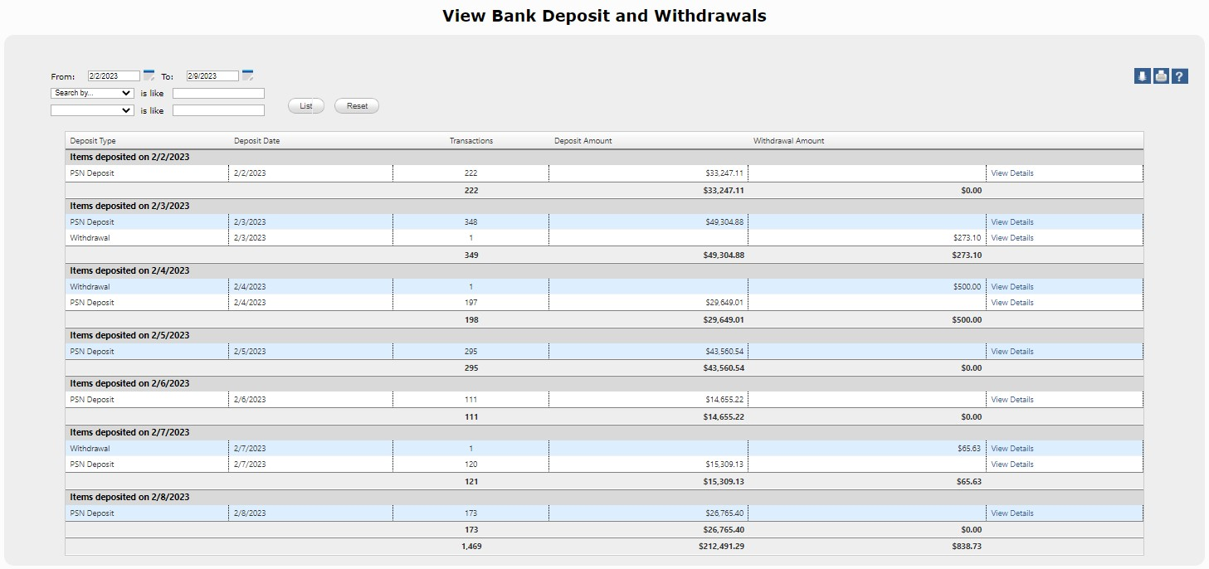
Daily Reconciliation of Deposits
If you’d like to do daily spot checks of deposits:
Under Quick Links, click View Bank Deposits
Check the deposit amount listed in PSN against the amount listed by your bank
Click on View Details to generate a report of the transactions making up the deposit

Slide 6
We recommend doing daily spot checks to make sure payments are posting from the PSN system to your software timely and accurately. If you have questions, please contact your Service Account Manager.

