Slide 1
How Your Customers Will Pay by Mobile App

Slide 2
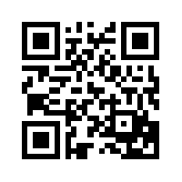
Smart Phone & Tablet Payments
If you have online payment services from PSN, you automatically get mobile app payment services.
Any customer who has an iPhone®, iPad® or Android™ phone or tablet will be able to download the free “PSN Payments” app. Customers can:
Scan the QR code (which should be on your website and your marketing pieces)
Download “PSN Payments” from the App Store® or Google Play™.
PSN Payments
If your company has a customized app from PSN, do not use the above directions or QR code. Your app will have a unique name and code. However, the customer experience is the same as the following slides.

Slide 3
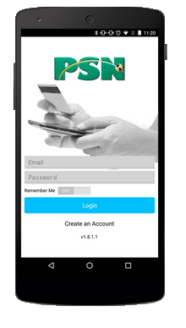
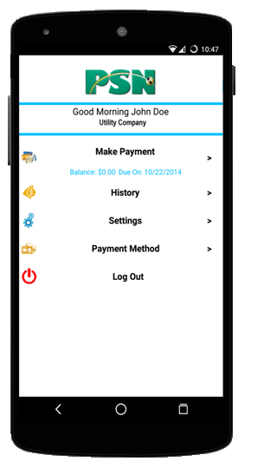
Logging into the mobile app
IMPORTANT: Before using the App, your customer should go online to set up his/her PSN Customer Profile. They can do this on their mobile device but it is easier on a regular computer.
Customer logs in with user ID (email) and password.
Customer chooses from the menu items…
Pay
View past payments
Change password
Add/delete a payment method

Slide 4
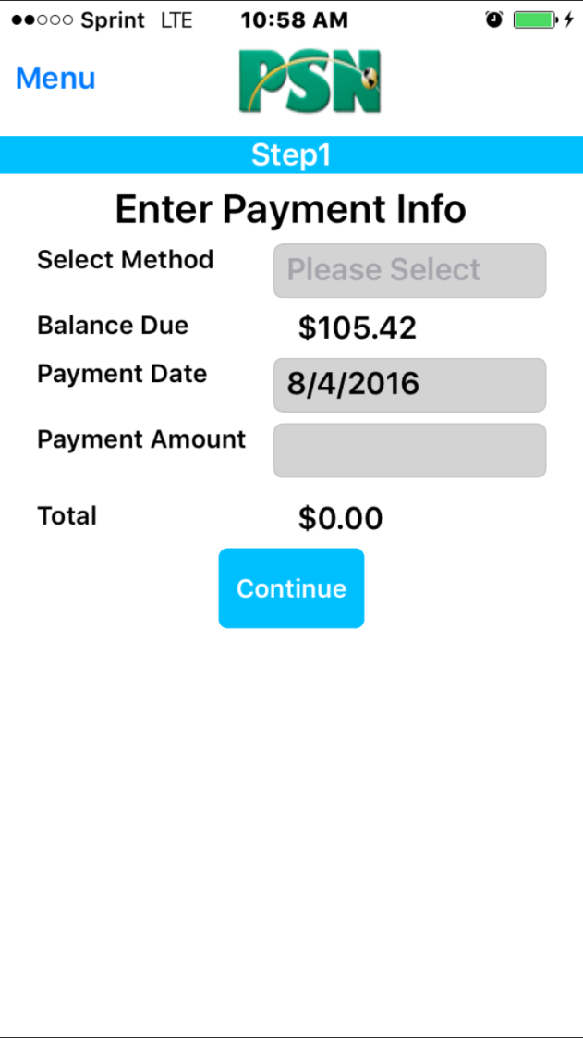
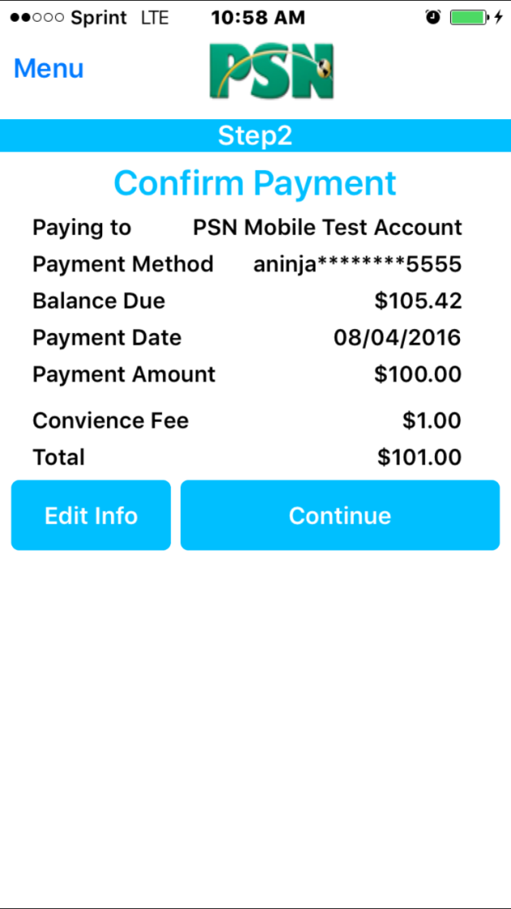
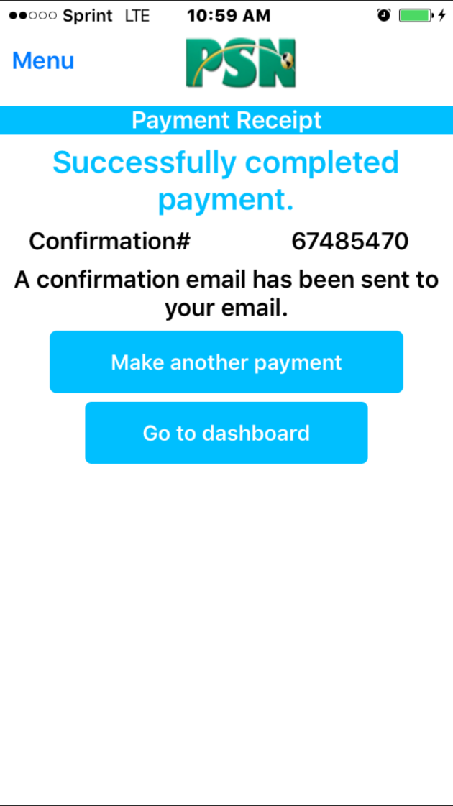
Making a payment
STEP 1.
Customer selects payment method, amount , date
STEP 2.
Customer confirms info
STEP 3.
Customer receives confirmation

Slide 5
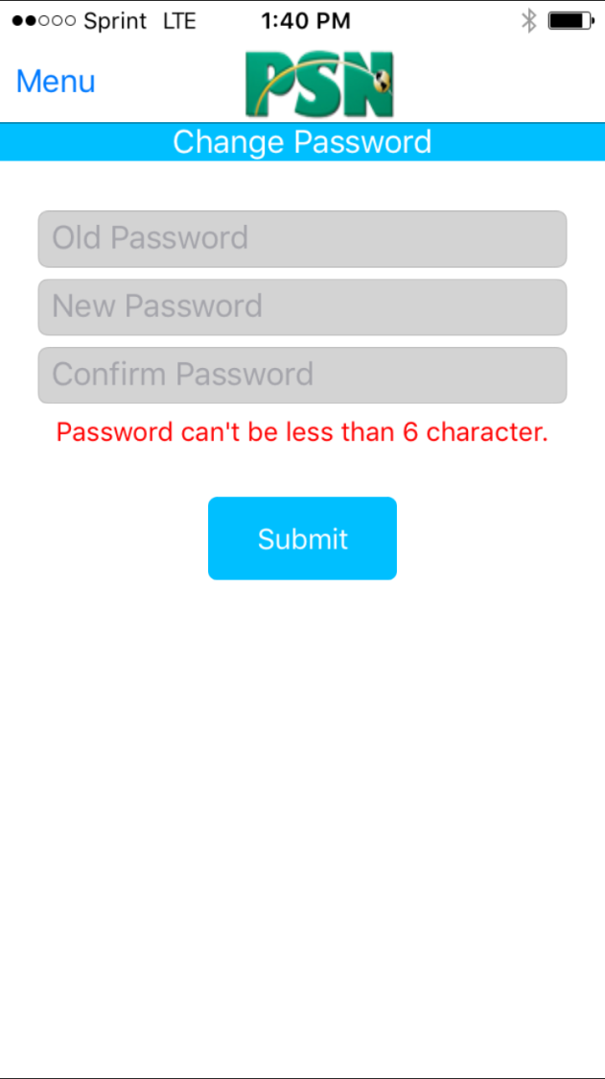
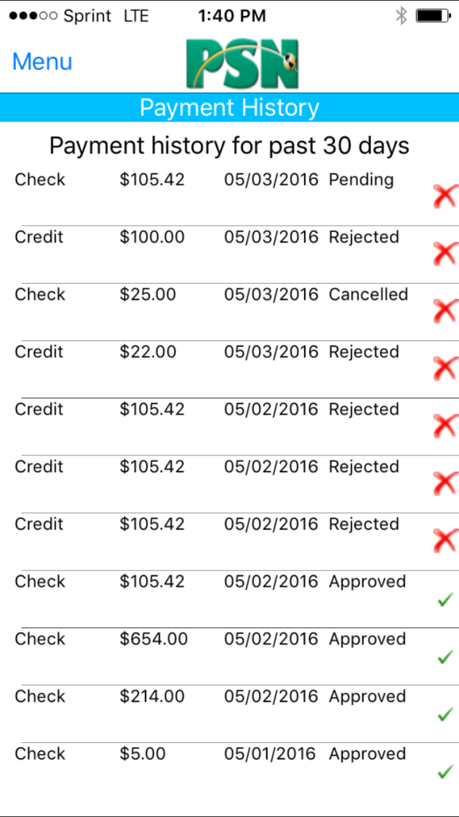
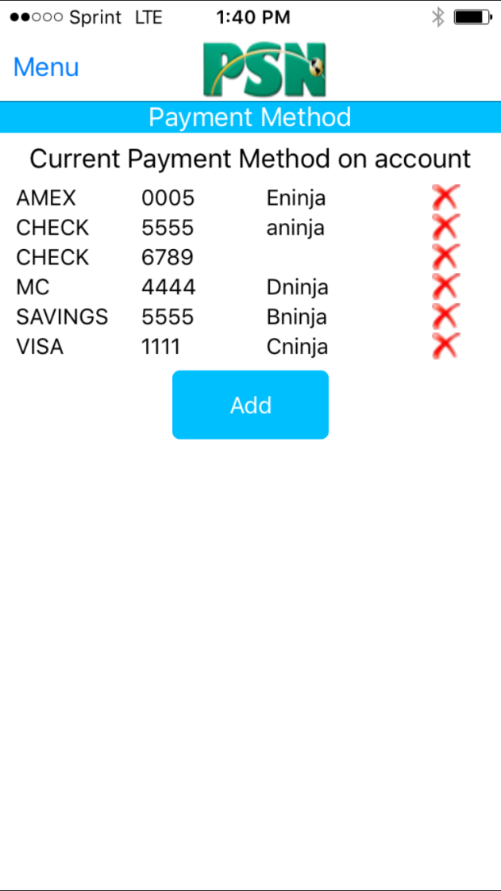
Other features
Change password
View payment history (no matter where payment was made through PSN—online, phone, mobile)
Add or delete payment methods

Slide 6
Contact your Service Account Manager for any additional information.
Hours: 8am-5pm CST
Voice: 866.917.7368
Email: CustomerService@PaymentServiceNetwork.com

